Slide 1
2022 Route Improvement Plan
City of Dayton

Slide 2
Republic Services acquired Randy’s Sanitation in Dec. 2020
RSG Routes and Hauling Services
Current State: The City of Dayton is serviced out of the Blaine Division and the St. Michael Division.
Future State: All routes will be serviced out of the St. Michael Hauling Division, as of March 28th, which will increase our speed of response and improve service to residents.

Slide 3
Proposal to Day Change from Friday to Monday
Number of home affected: 1,235
Date of Change: March 28, 2022
Scope of Change: 2 Recycle routes (both remain gray week) and 1 Trash route.
Trash is Open Market and, in the area, noted on page 4 Republic Services collects approximately 54% of the customers leaving 46% as serviced by other haulers.

Slide 4
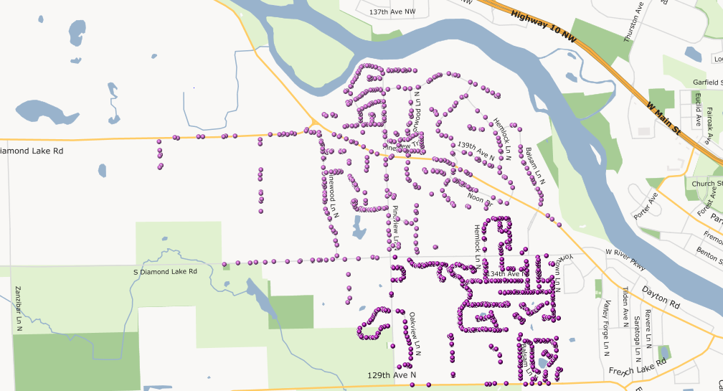
Map of Day Change moving Friday Service to Monday

Slide 5
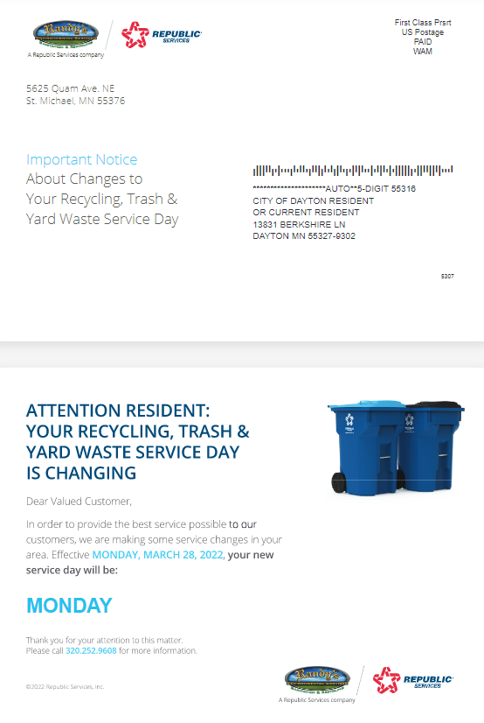
Mailer - Dayton Standard Day Change (trash and recycling serviced by Republic, Moving service from Friday to Monday)

Slide 6
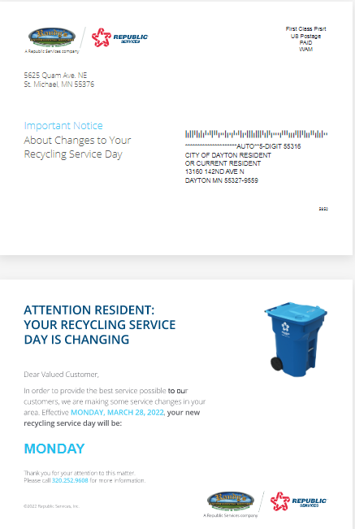
Mailer- Recycle Day Change, Friday to Monday (competitor hauls trash)

Slide 7
Proposal to Day Change from Friday to Tuesday
Number of home affected: 673
Date of Change: March 28, 2022
Scope of Change: Moving one Route from Friday to Tuesday; Recycling week remains Gray week (see next page for map)
Trash is Open Market and, in the area, and Republic Services collects 597 trash customers. We estimate that is 85% of the customers in this area leaving approx. 15% serviced by other haulers.

Slide 8
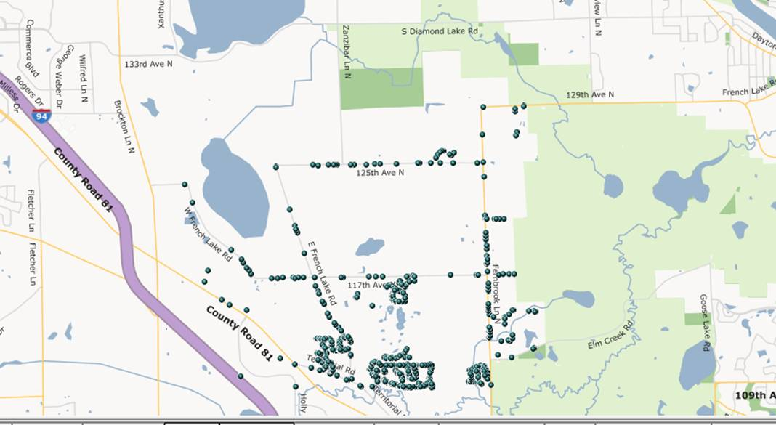
Map of Day Change moving Friday Service to Tuesday

Slide 9
Mailer - Dayton Standard Day Change (trash and recycling serviced by Republic, moving service from Friday to Tuesday)
Please note that the front side of postcard will be identical to that shown on page 5

Slide 10
Mailer- Recycle Day Change, Friday to Tuesday (competitor hauls trash)
Please note that the front side of postcard will be identical to that shown on page 6

Slide 11
Why the Change?
These collection day changes provide Republic Services the ability to balance out headcount allowing us to stay efficient, keep costs down as much as possible, and provide better service. Most importantly, this change allows for RSG to have a faster response time for City of Dayton residents as we will be in the City more than once per week. And lastly, the City continues to grow. By expanding the collection schedule now Republic is better positioned to allocate additional resources as needed.

Slide 12
Communication-Transition Plan
All affected residents will be notified via mail; generally, we send a postcard notification
When we transition the service weeks, RSG will pick up recycling two weeks in a row and then resume every other week service with the new schedule.
If the City can provide a list of residential phone numbers RSG will also issue call-em-all announcements and reminders to all residents affected. Otherwise, we can do so with those we have on file.
An address list will be provided to City Staff in advance of the transition as a reference should a resident call in.

