Slide 1
City Council
July 9, 2019

Slide 2
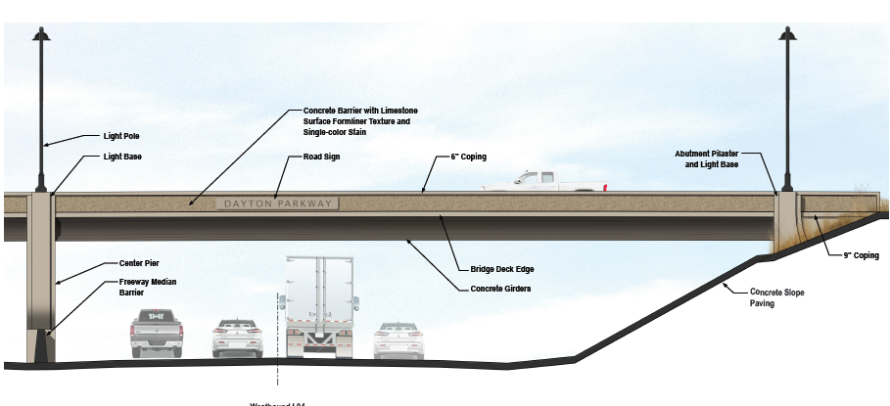

Slide 3
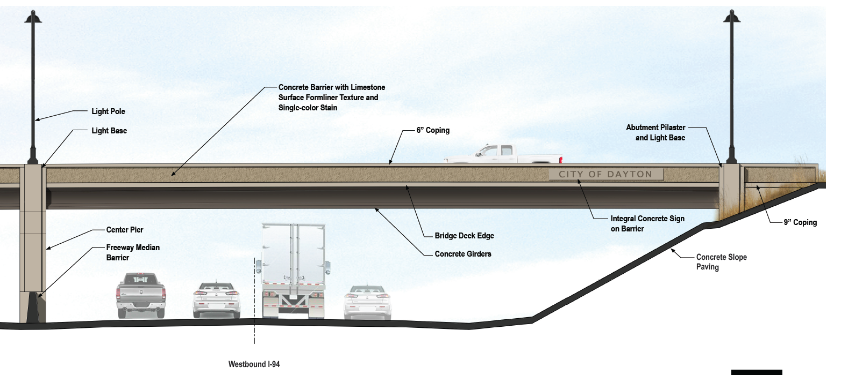

Slide 4
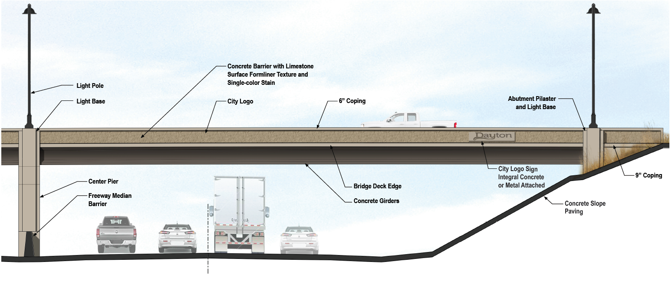

Slide 5
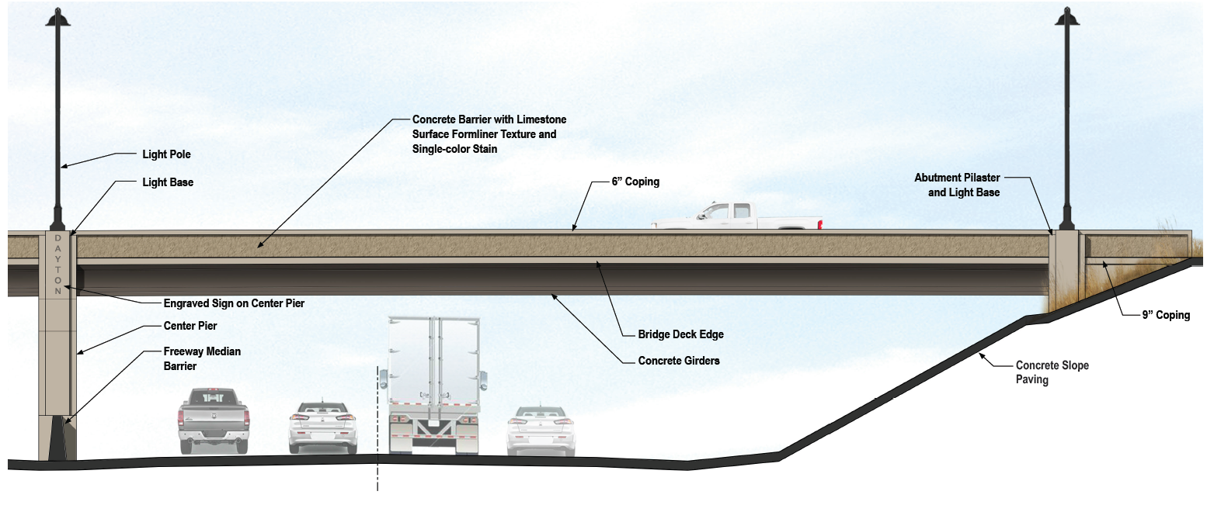

Slide 6
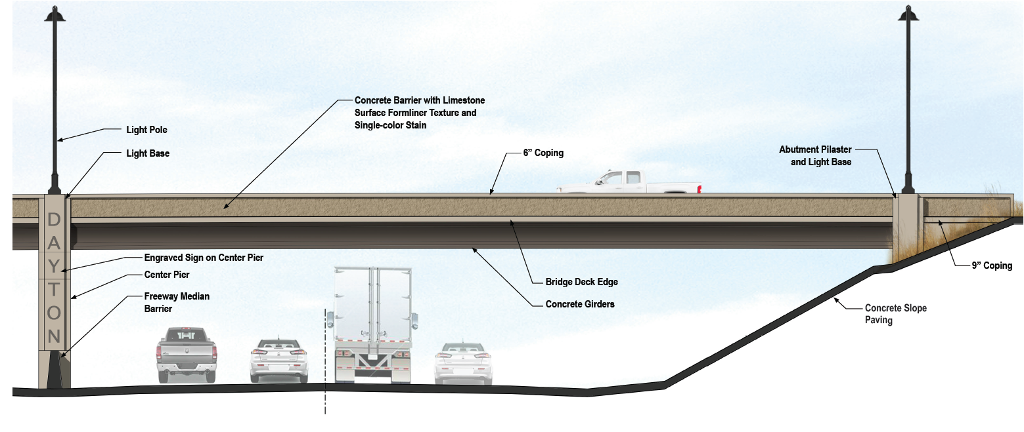

Slide 7
Resolution for Deferrals
Properties with improvements that are functionally or financially obsolete; with improvements that do not significantly contribute to the overall value of the property;
Properties that have not been improved with improvements that are consistent with the property’s guided highest and best use under the comprehensive plan; including non-conforming properties
Properties that are vacant
Other deferrals as allowed under state statues 435.193 and city code 34.38
Senior citizens
Military
Disabled
Green Acres

Slide 8
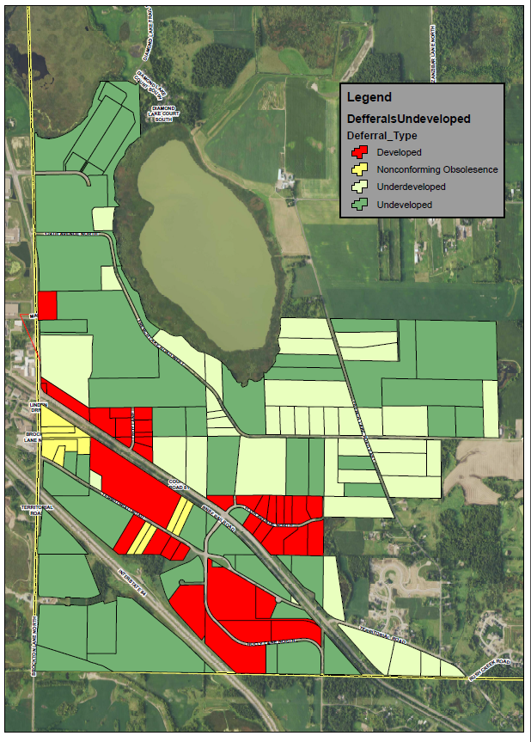

Slide 10
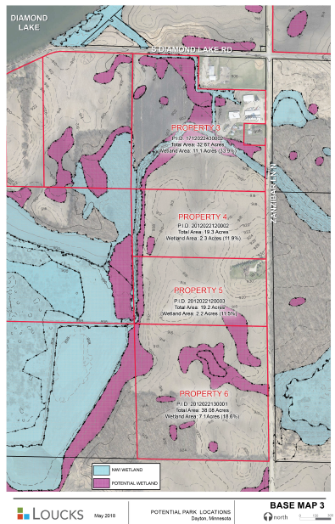
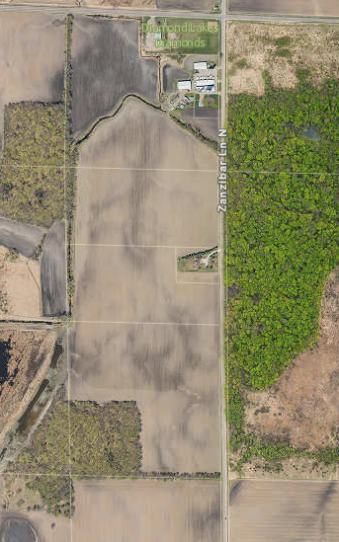

Slide 11
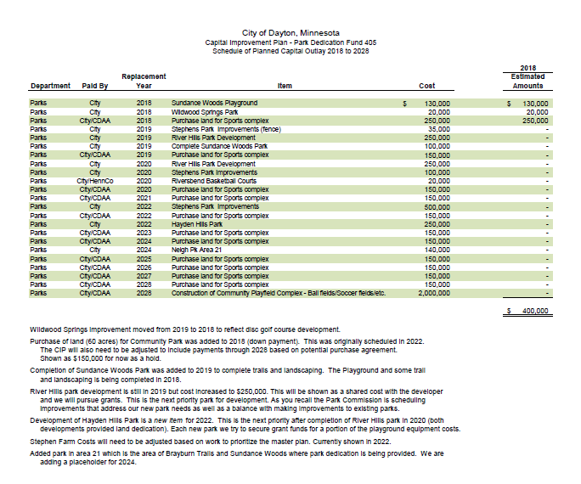
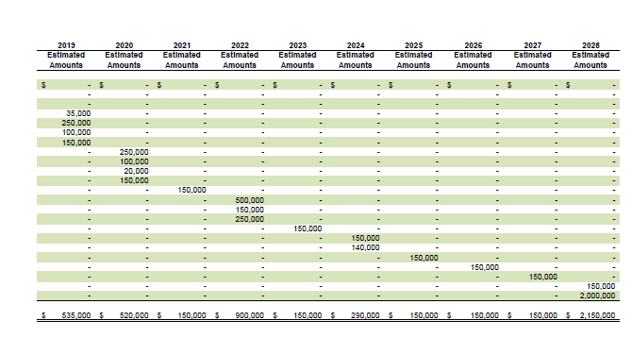

Slide 12
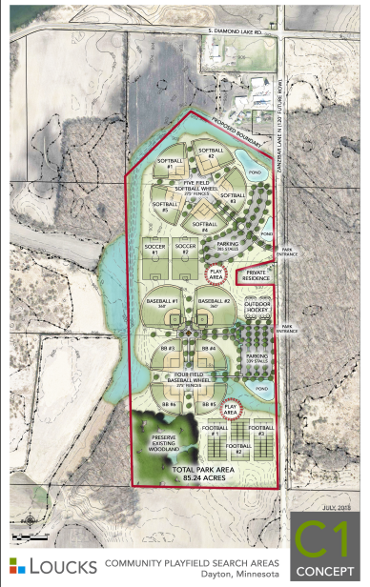

Slide 13
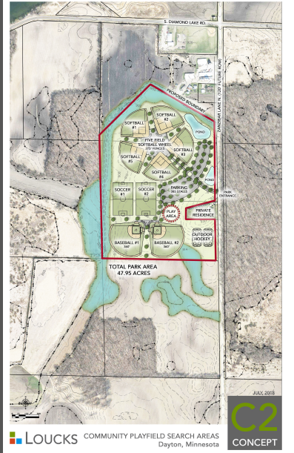

Slide 14
Original request- contract for deed with 4% up to 20 year pay-off
Property 3 (32.67 ac) -$19,000/acre
Property 4 (19.3 ac) -$21,000/acre
Property 5 (16.7 ac) -$21,000/acre
Property 6 (38 ac) -$23,000/acre
Council previously considered $16,000 ac
Could pay over 20 years
Propose 2.75% interest
$1,363,840 based on net 85.24 acres
With 20 year payoff at 2.75% - $88,000/yr
At $18,000 acre- $1,516,320- $99,000/yr
CIP includes payment of land for sports complex -$150,000 starting in 2019.

