Slide 1
New Financial software
Moving to BS&A

Slide 2
Changes for residents
All account numbers will be changing. If a resident has auto pay set up through their bank they will need to update their account number for payment to be applied
PSN will be replaced with InvoiceCloud this will offer more ways to pay for utility bills and escrow payments
Bills will be a full page with a usage chart. Residents will receive one last post card bill
Penalty bills will no longer be sent out. The penalty and previous amount will be reflected on the next bill

Slide 3
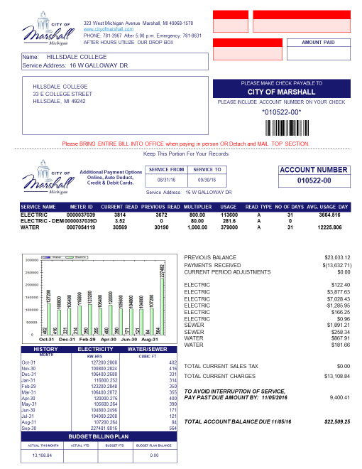

Slide 4
InvoiceCloud
Studies show payers are happier when multiple payments channels are offered.
InvoiceCloud is a level 1 PCI compliant with double data encryption-unique

Slide 5
New services
Residents will have the option to get email or text message reminders of a bill coming due

Slide 6
Key changes for the city
The cost to change to a full page bill will be an added expense of $375 per billing cycle. One thing that could be considered is increasing the base fee for water and sewer
The cost of changing over to InvoiceCloud is additional cost historically the City has absorbed these fees and just wanted to check and see if that is still Council direction
Other fees to discuss: does the Council have any interest in adding fees that we currently absorb like street lights the City pays $35,000 per year or recycling the City pays $88,800 a year and these numbers are increasing the cost goes up for the services, we have added residents and the grant gets smaller every year
Other fees that the City will continue to absorb will be yard waste, dog rescue and Gopher state one services

Slide 7
New features
Staff is excited for some of the new features and thinks this will give residents the most options and they can pick what is best for them!
Most common issue we hear now is that residents did not receive a bill. Staff thinks that moving to a full page will help and with the ability to log into their utility accounts and view everything, set reminders, call to pay and set up auto payments we should avoid the frustration of not receiving a bill

