Slide 1
Interchange Master Plan Area Status Update
July 9, 2019

Slide 2
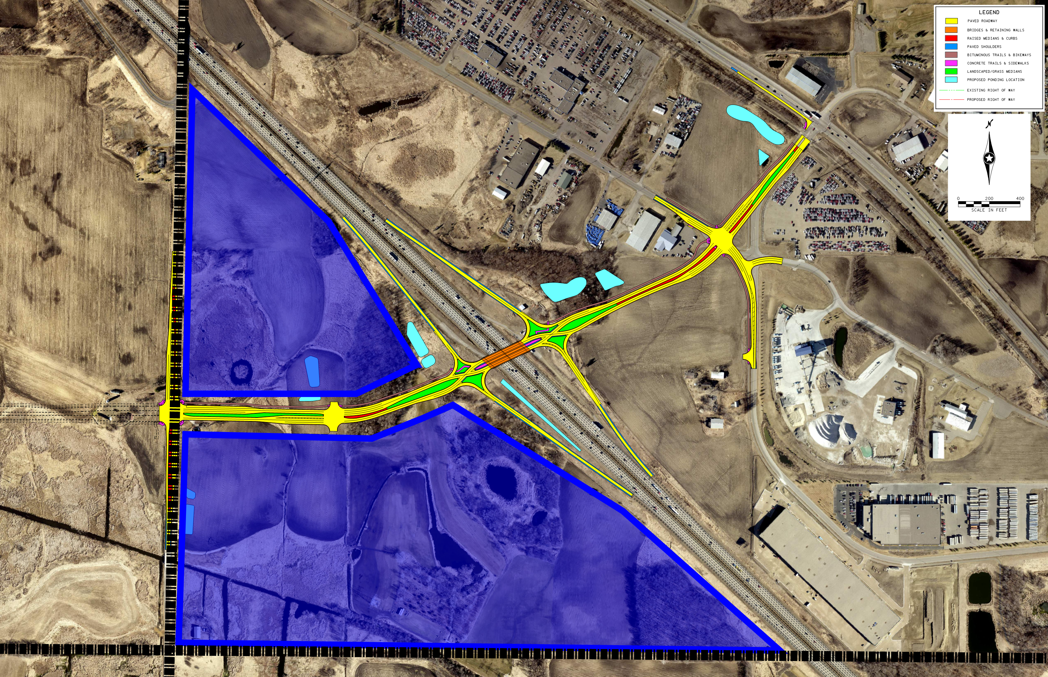
Interchange Master Plan Area

Slide 3
Status Update
Property owners contacted
Appraisals initiated
Wetland delineation approvals in process
Concept of creating a wetland bank supported

Slide 4
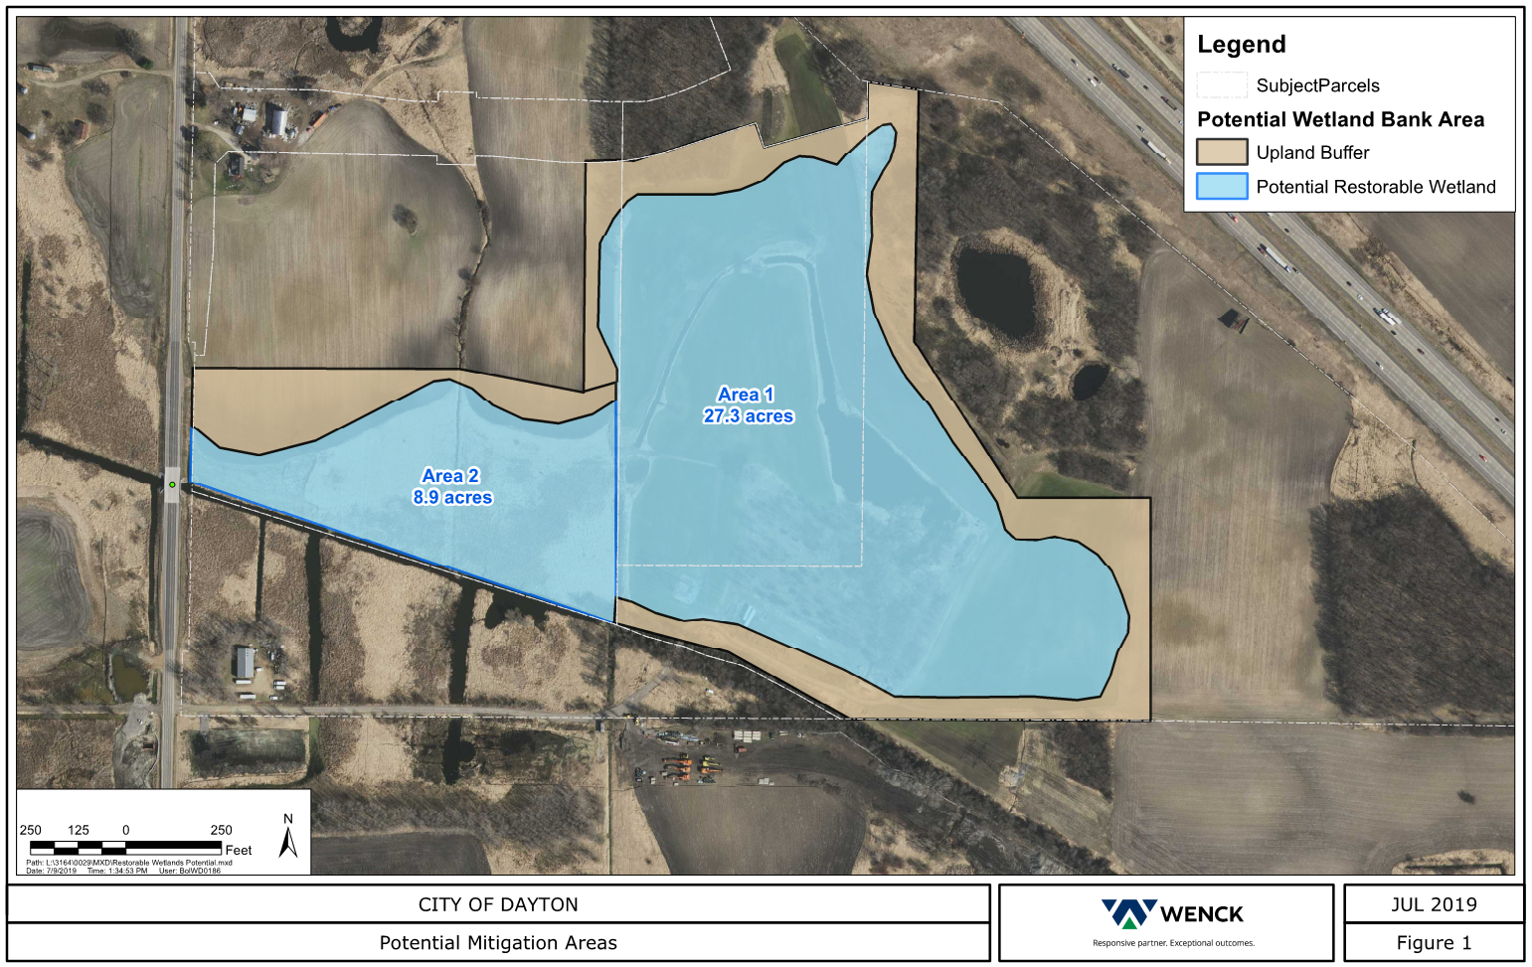
Potential Wetland Bank Areas

Slide 5
Status Update
Property owners contacted
Appraisals initiated
Wetland delineation approvals in process
Concept of creating a wetland bank supported
Potential development scenarios evaluated

Slide 6
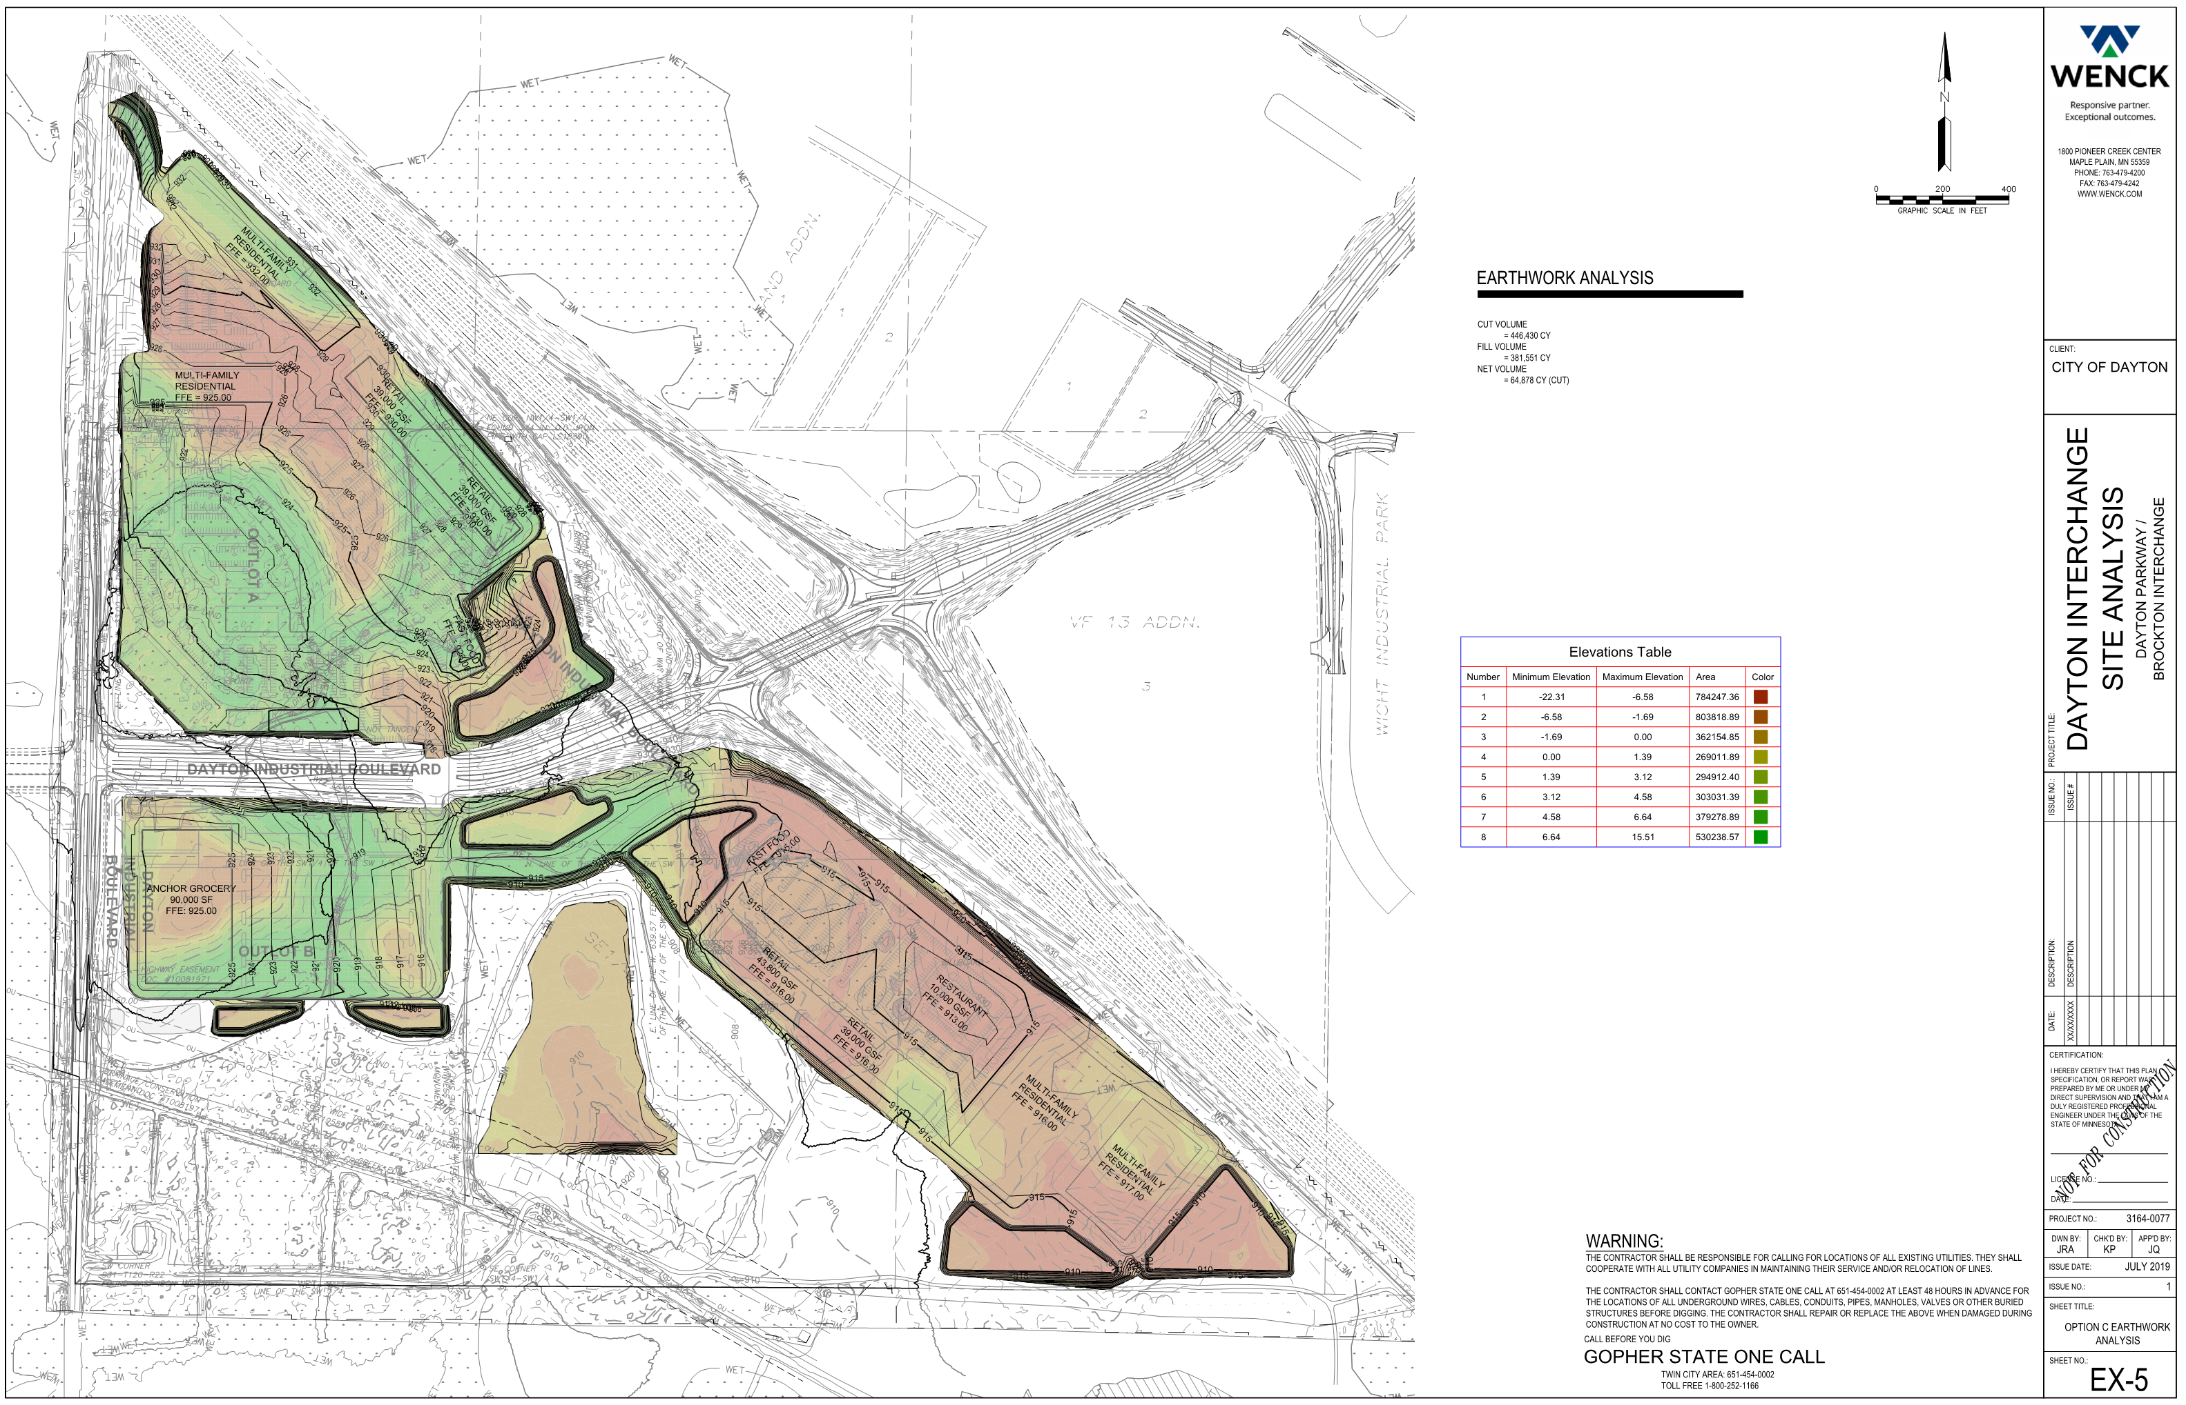
High Intensity Scenario

Slide 7
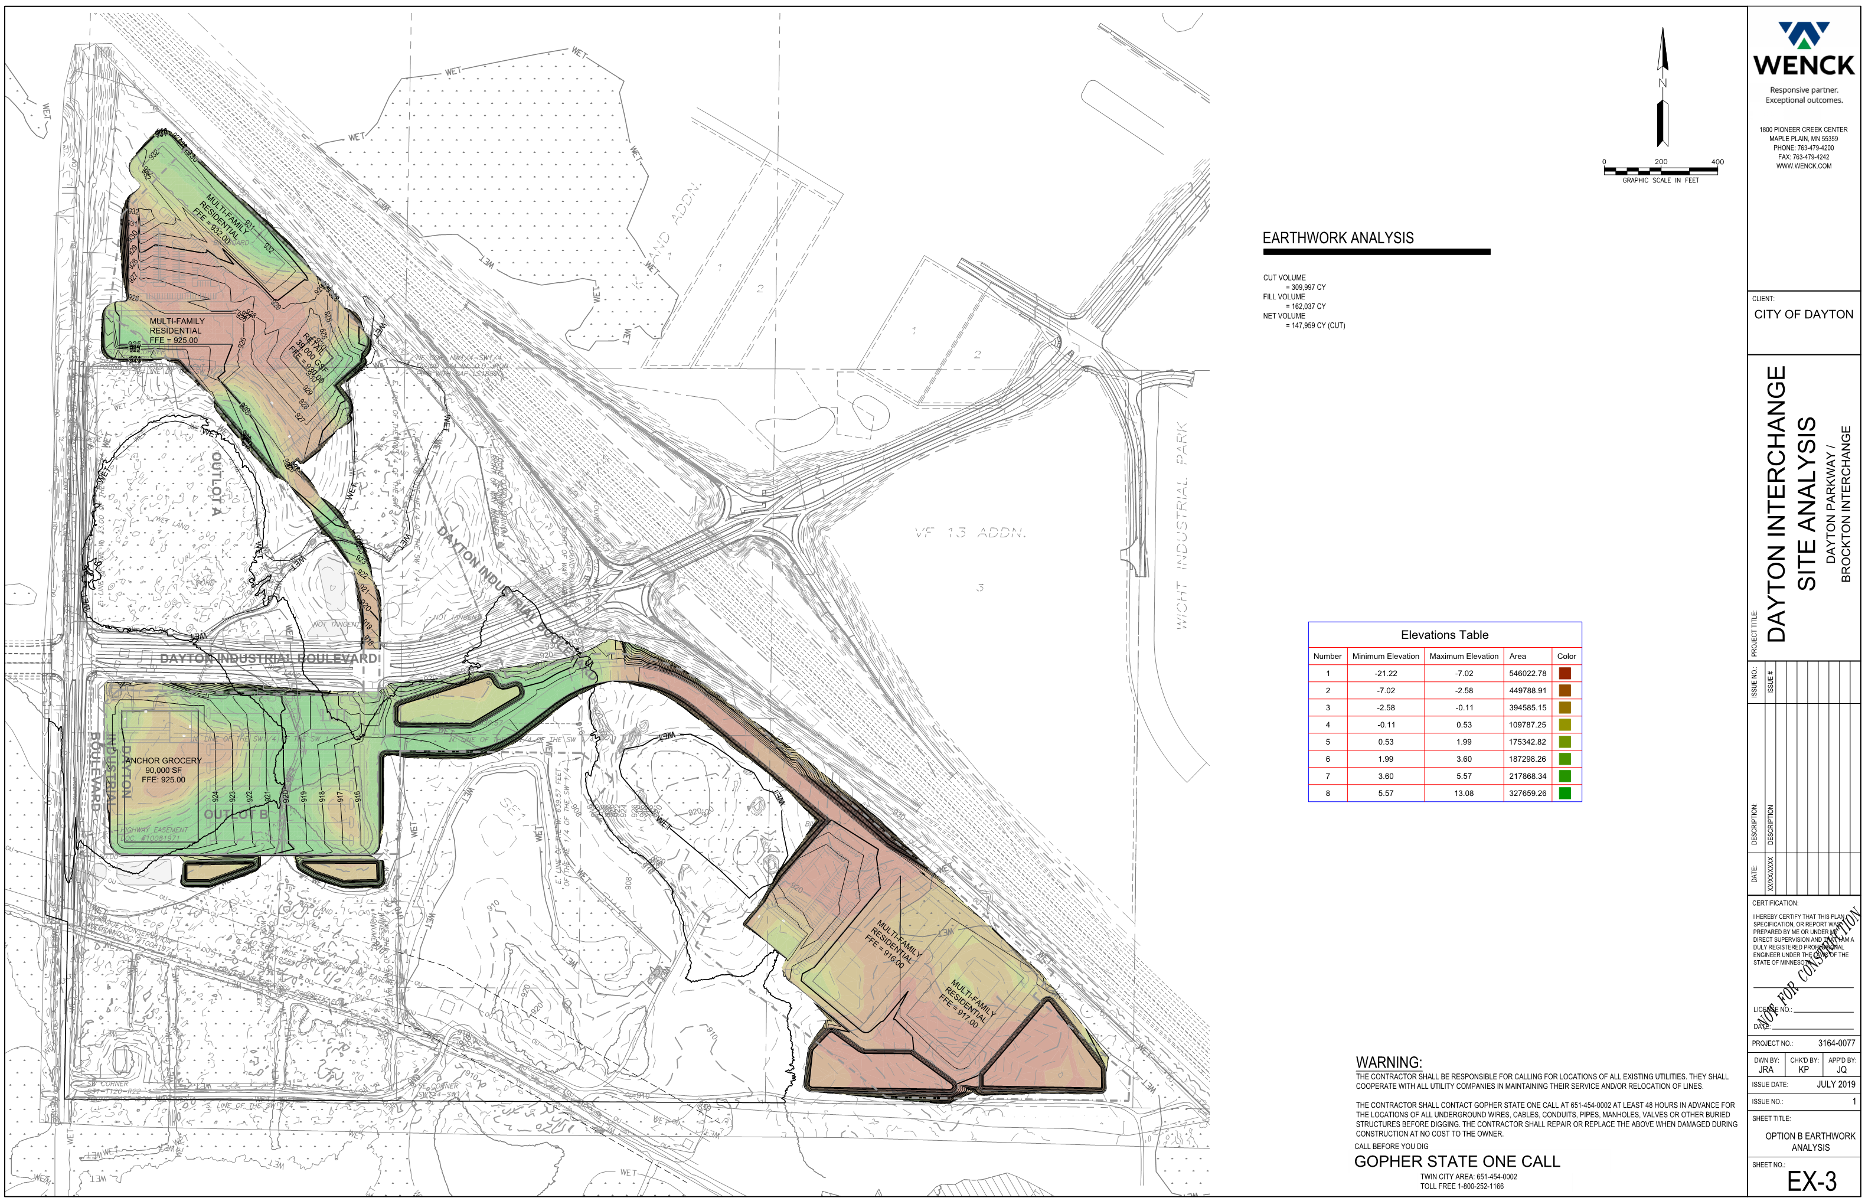
Low Intensity Scenario

Slide 8
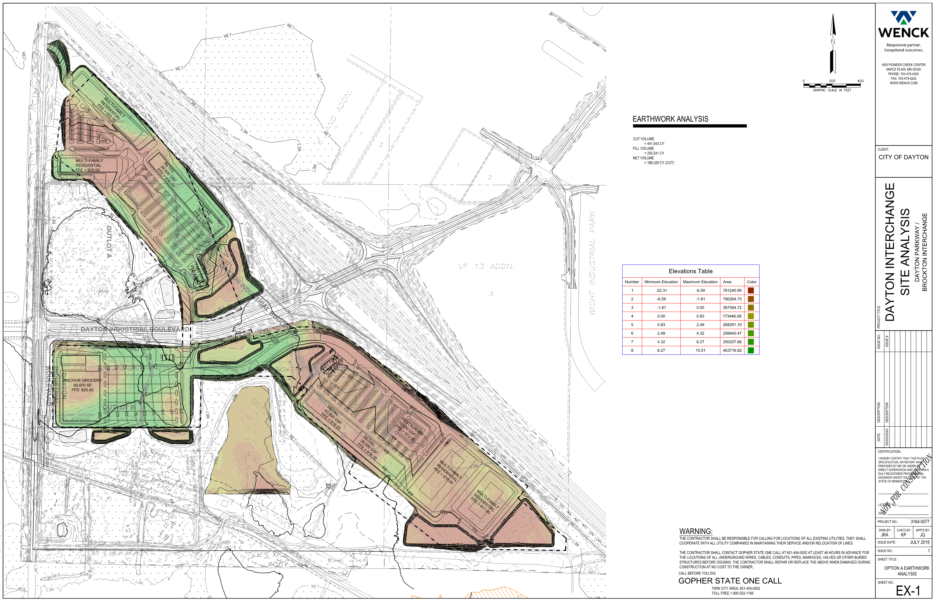
Moderate Intensity Scenario

Slide 9
Status Update
Property owners contacted
Appraisals initiated
Wetland delineation approvals in process
Concept of creating a wetland bank supported
Potential development scenarios evaluated
Varying levels of development intensity
Varying levels of impacts (wetland & floodplain)
Varying levels of material generated (50-200k+)

Slide 10
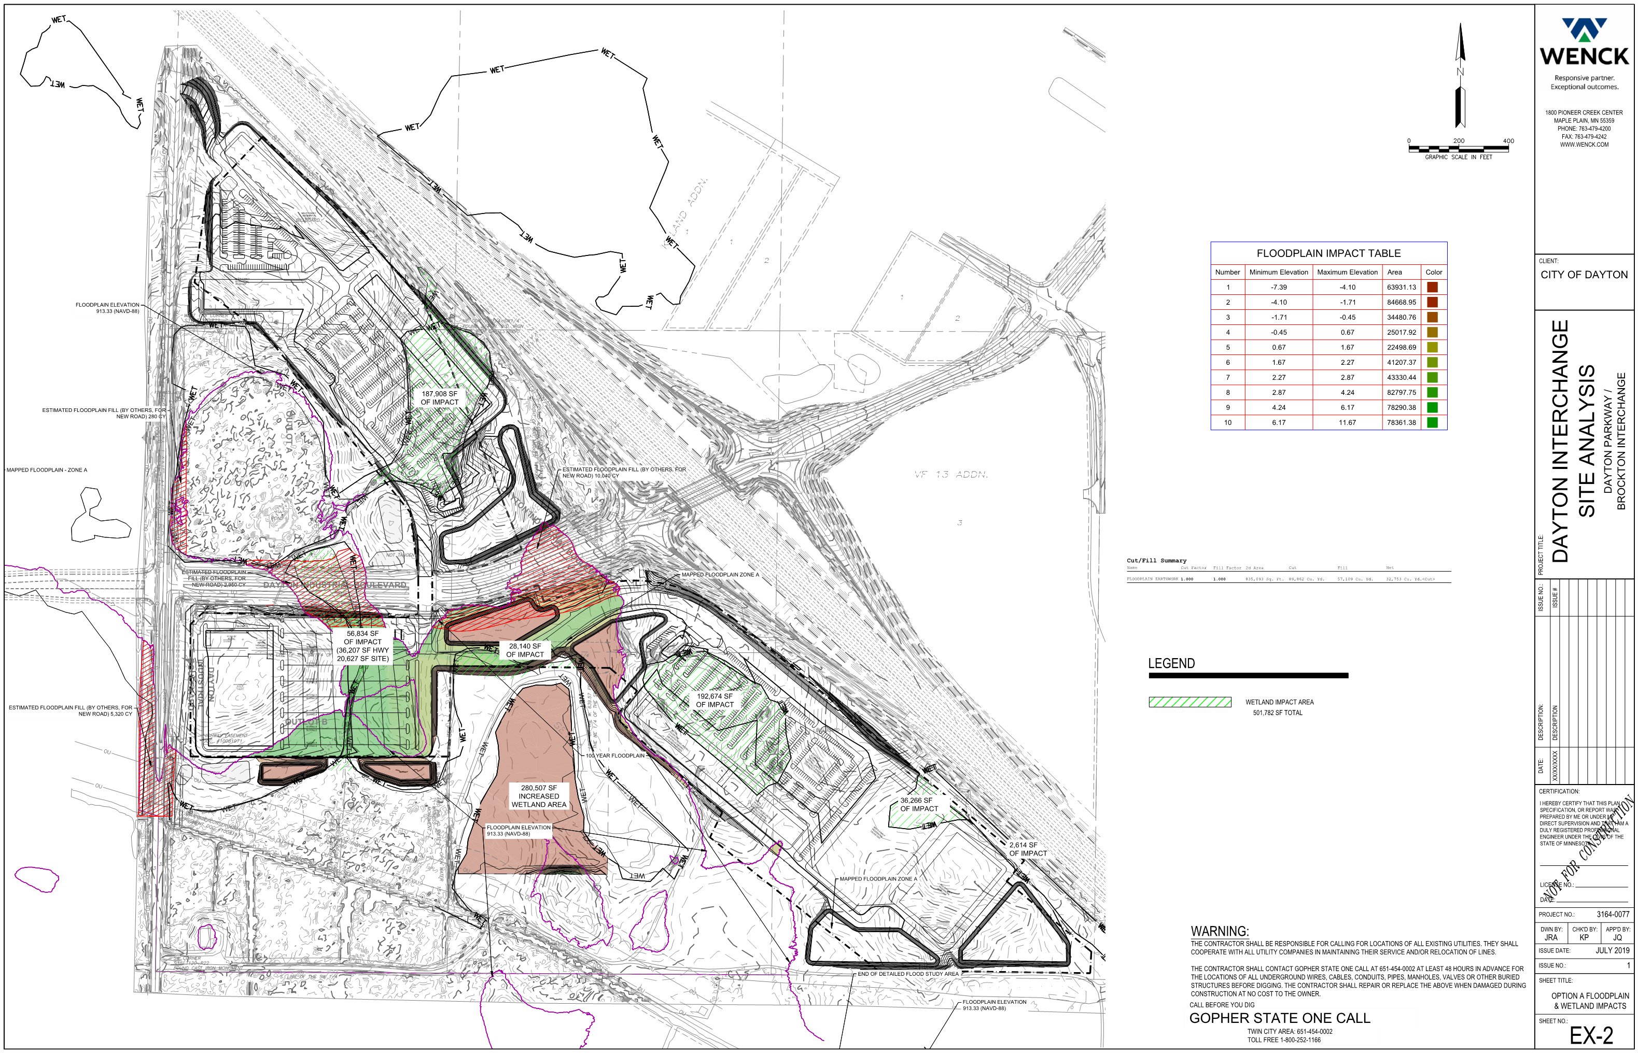
Moderate Intensity Impacts

Slide 11
Important items to note
Conceptual development scenarios (very) high level…
Permitting agencies not consulted,
Soil properties not confirmed,
Specific design/uses not discussed (in detail) with property owners
Ability to create a wetland bank is not a given…
Approvals often difficult to obtain
Expect 3yr minimum for approvals

Slide 12
Development is a balancing act!
Maximize development area…minimize impacts
Wetland impacts…wetland mitigation
Floodplain fill…floodplain mitigation
Wetland creation vs. potential development area
Many agencies involved in reviews/approvals
Multiple property owners = multiple objectives/expectations?

Slide 13
What’s Next?
Continue communications with property owners/representatives
Develop wetland bank concept – seek regulatory agency input
Finish appraisals – consider easement needs
Further develop concepts and earthwork quantities
Continue coordination with interchange project

Slide 14
Questions?
Notes:
This presentation, along with answers to other frequently asked questions can be found on the City’s website.

