Slide 1
Stephens Property Progress Report
2015 - 2017

Slide 2
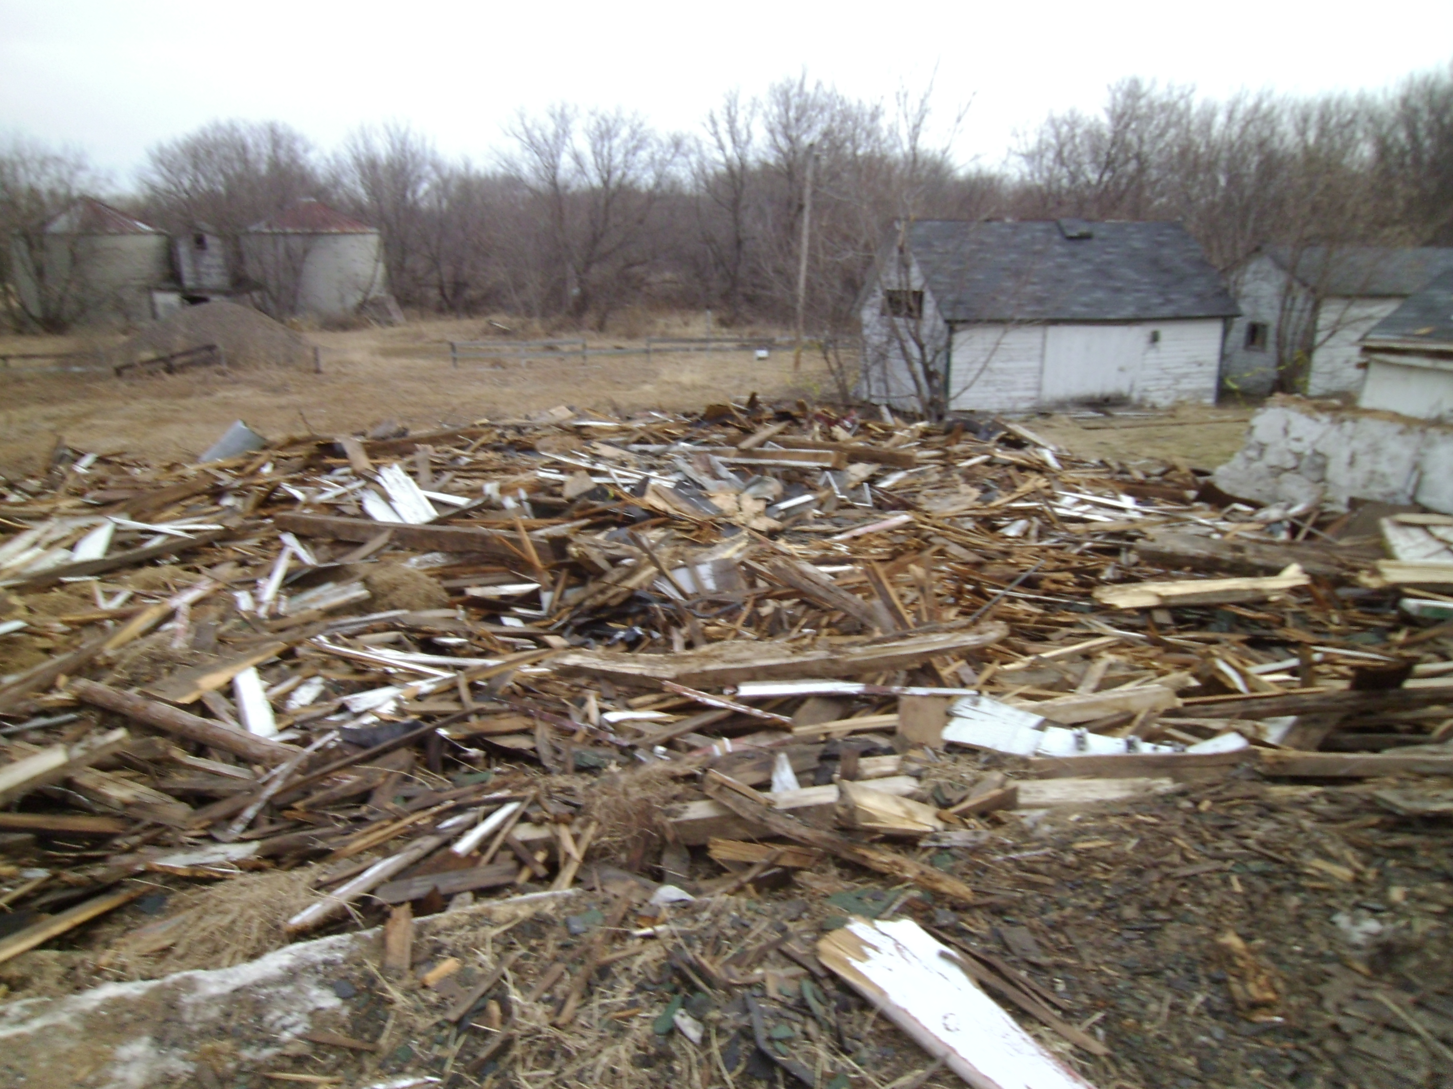
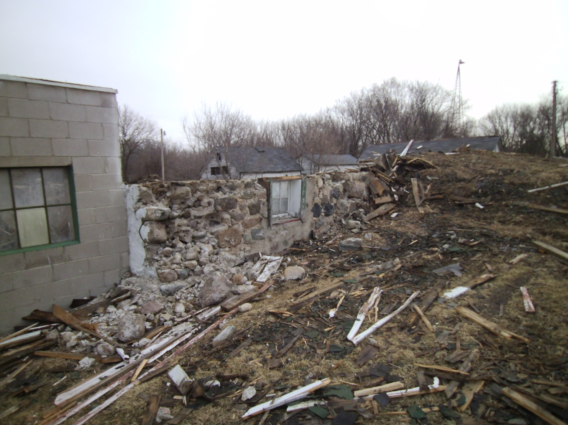
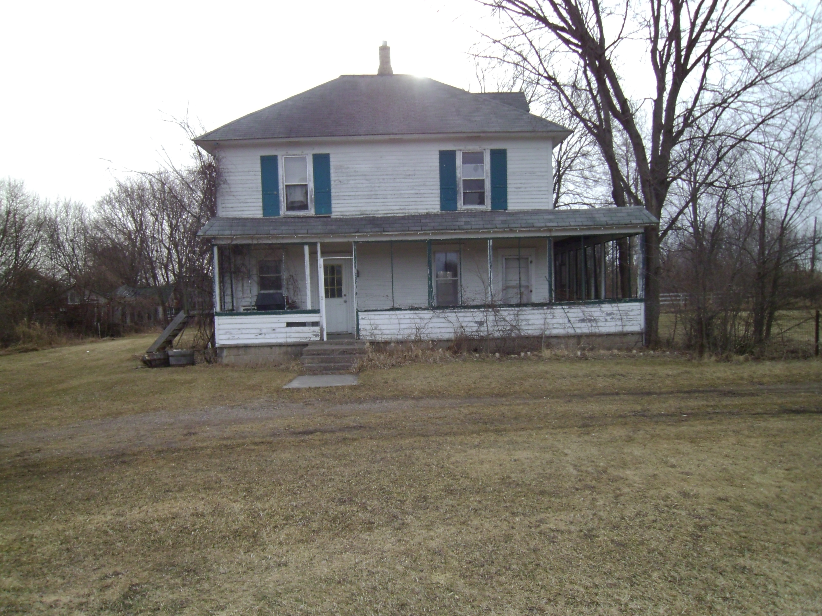
2015 Farmhouse

Slide 3
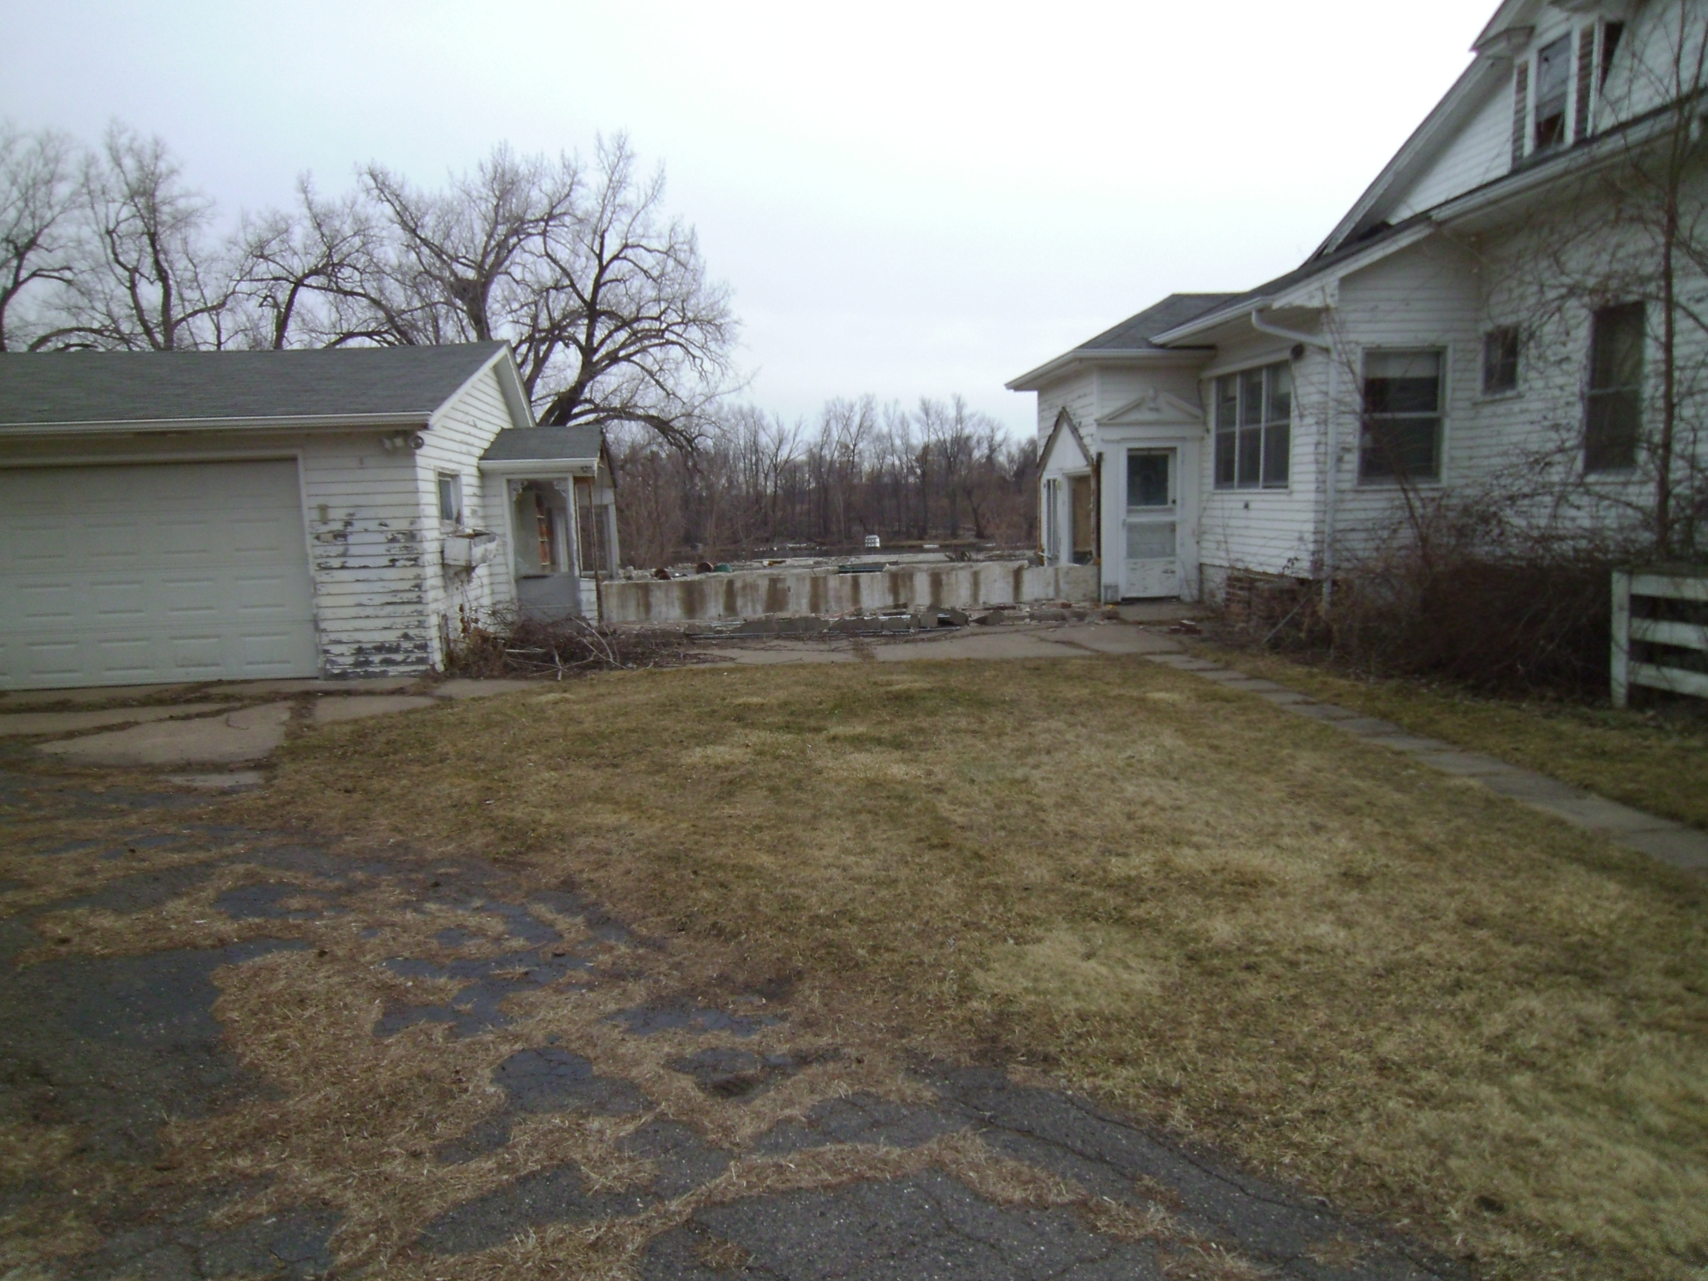
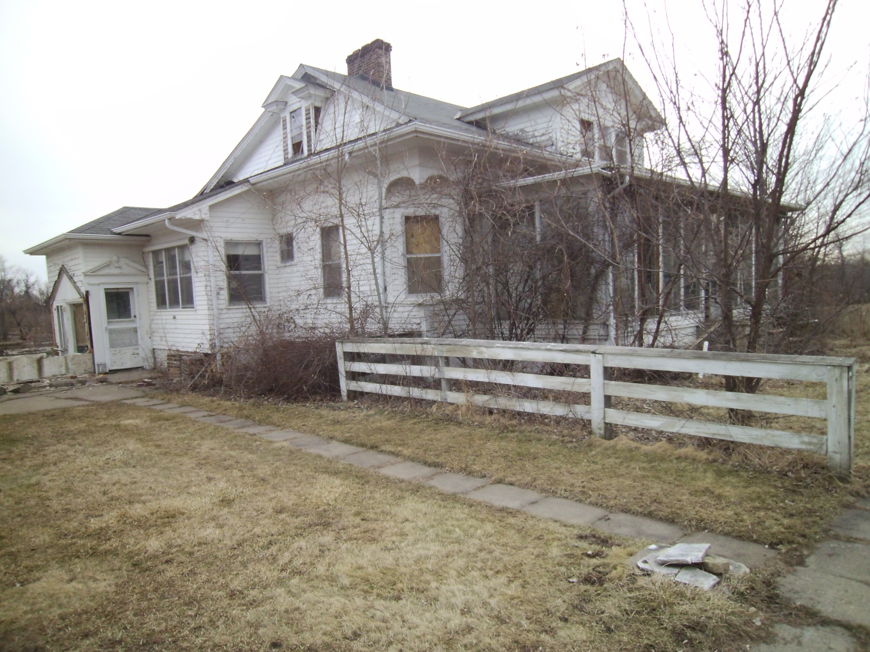
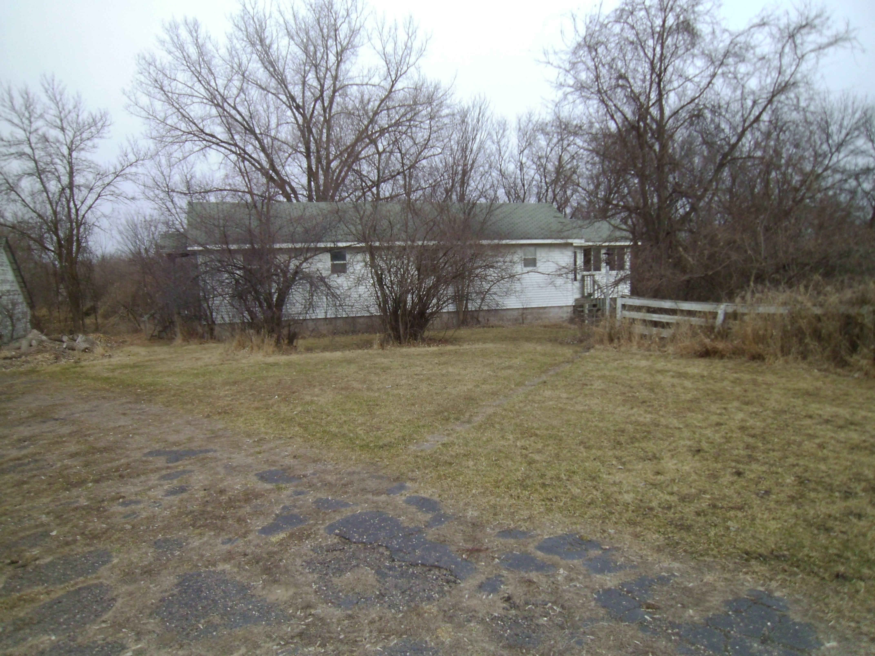
2015 Main House

Slide 4
2015
In 2015 the main barn on the farmhouse had collapsed into itself, the site had to be stabilized it was not in a safe condition so the roof and timbers were pushed into the foundation.
The Main House had been stripped of anything of value and all of the outbuildings had been picked through. Gardens were overgrown, the grass areas had been regularly mowed. The swimming pool had been filled and seeded for safety reasons.
The farmhouse and the main house both had asbestos in them, which needed to be abated by a licensed contractor.

Slide 5
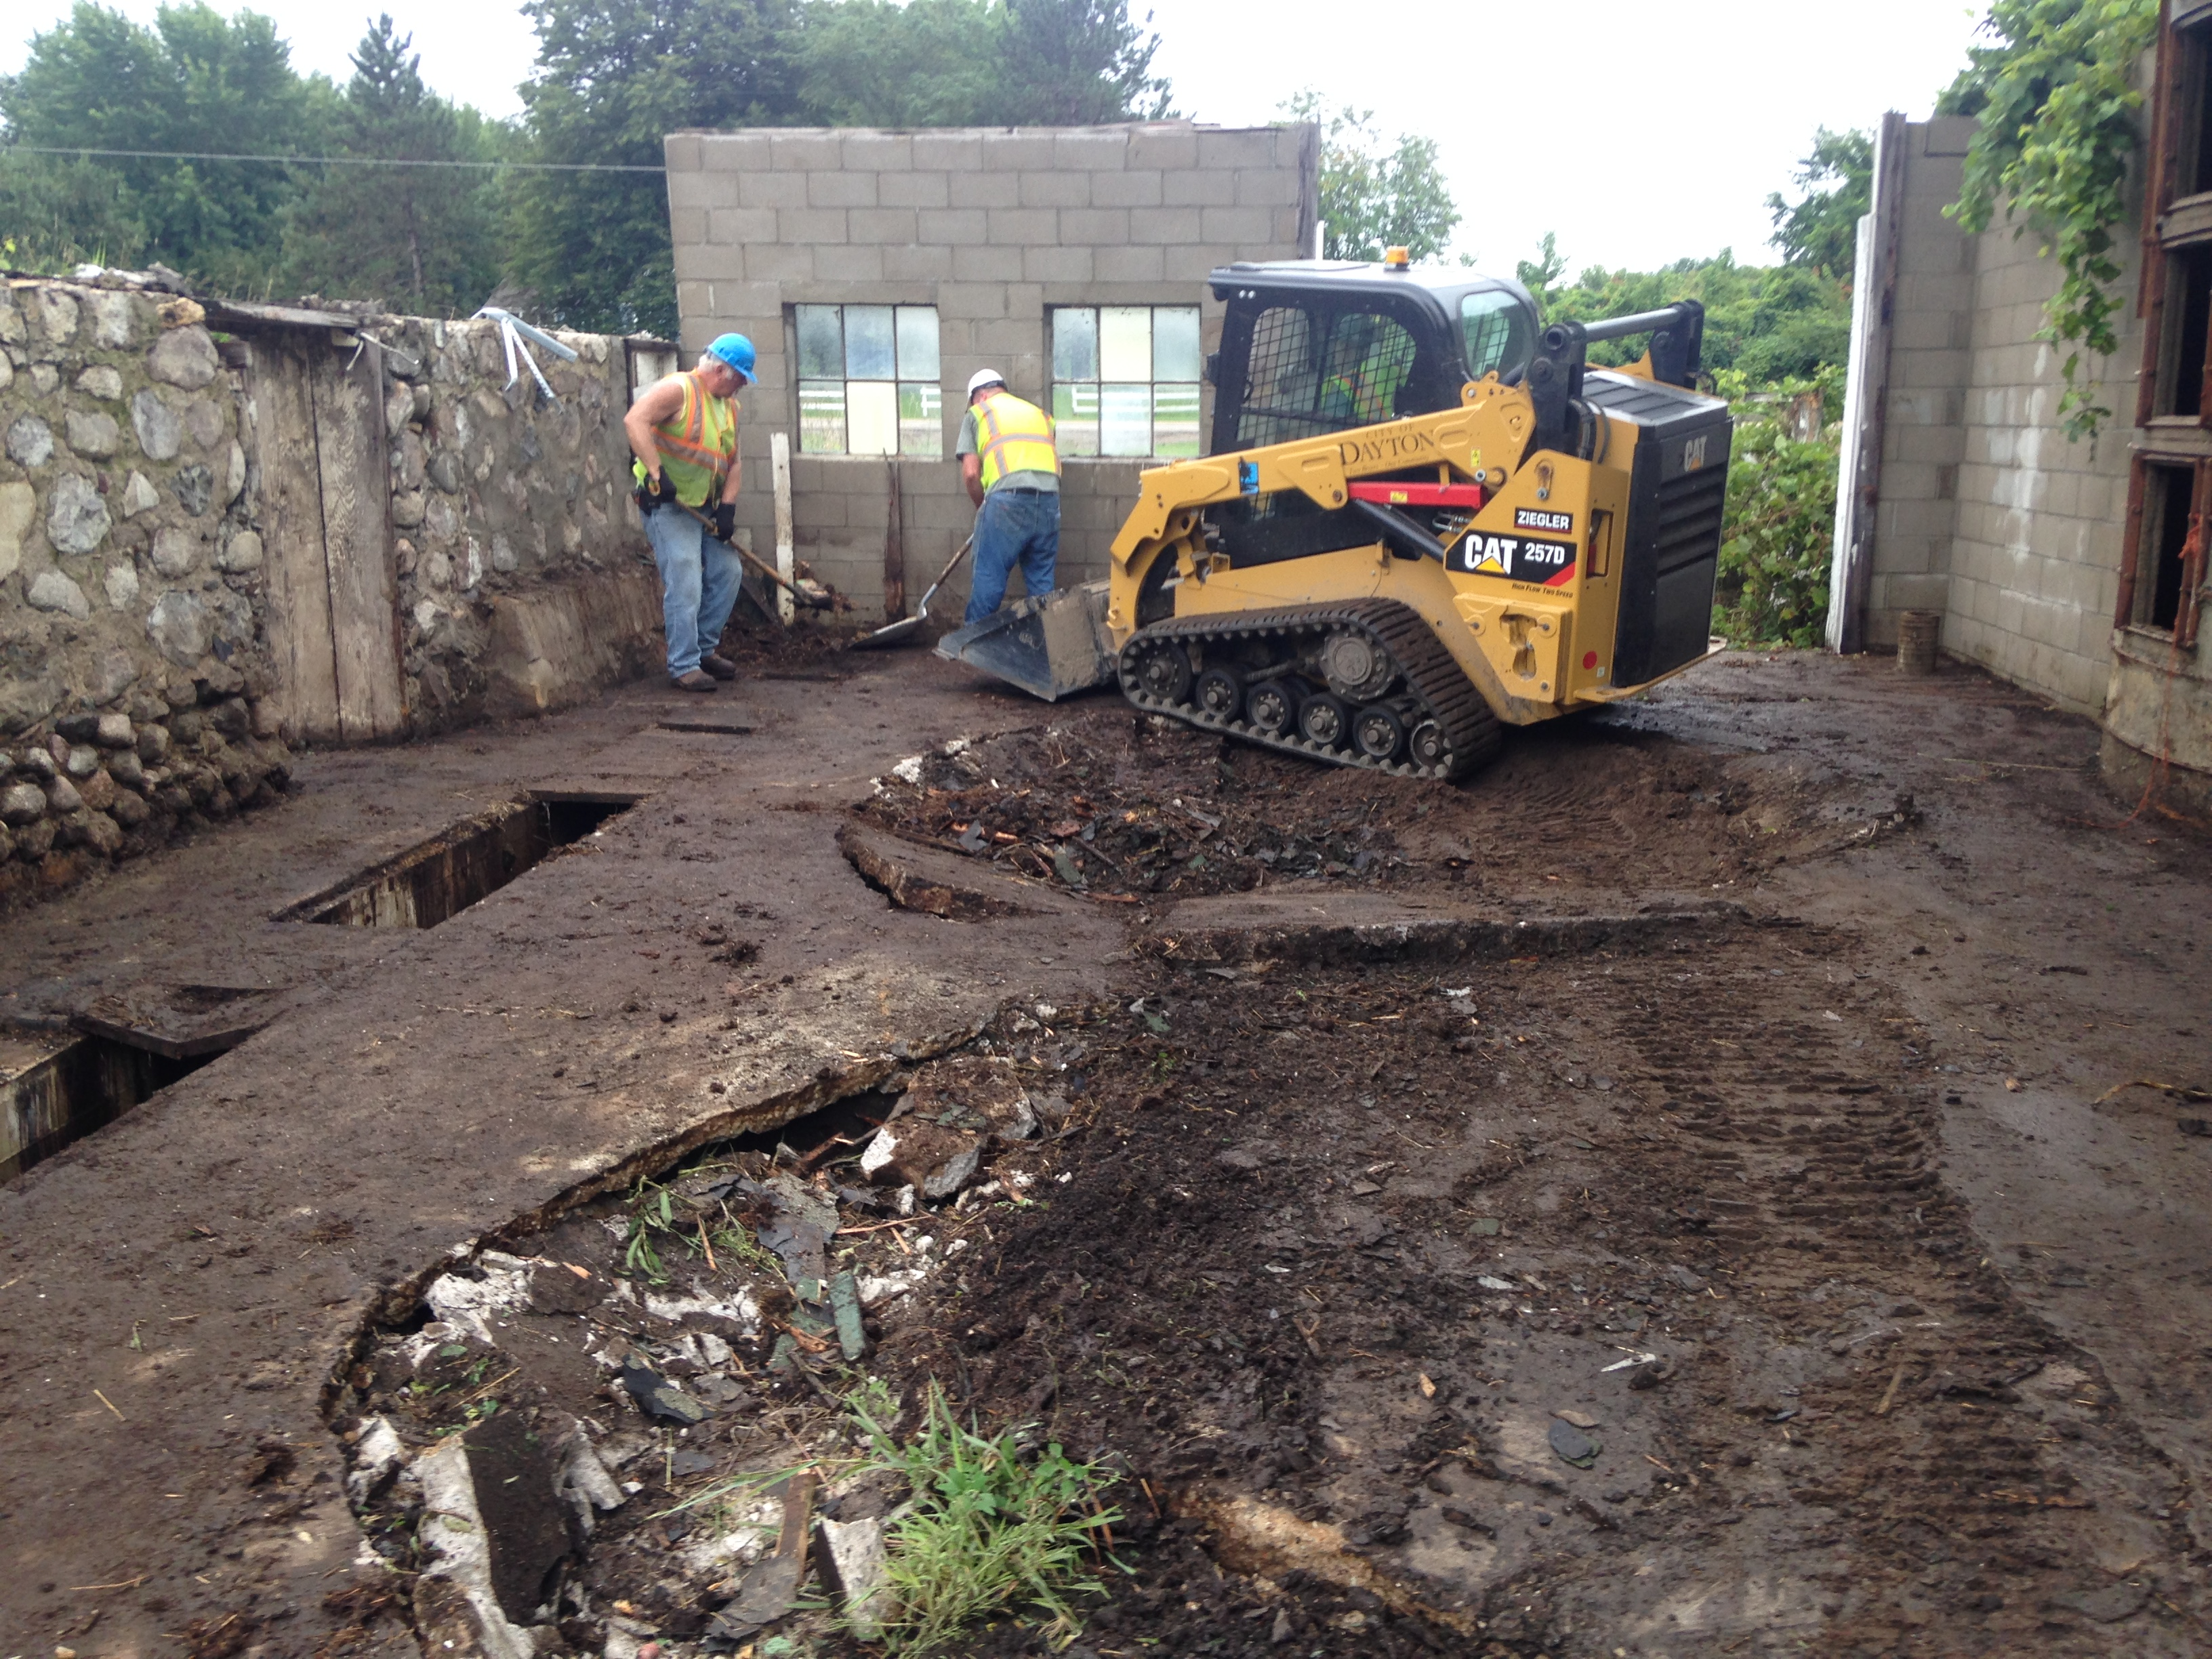
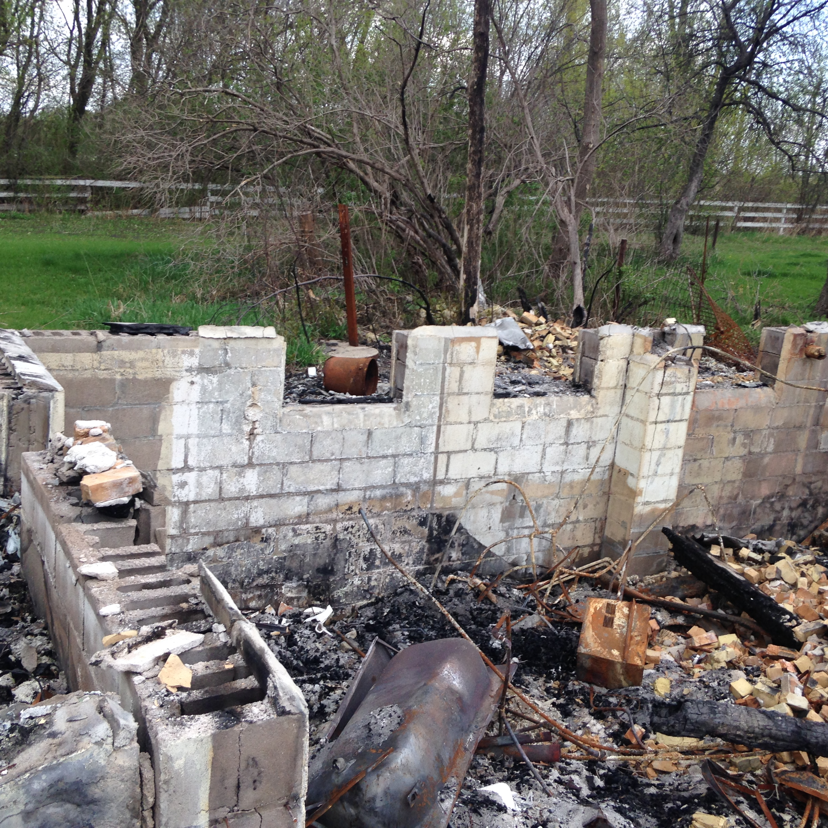
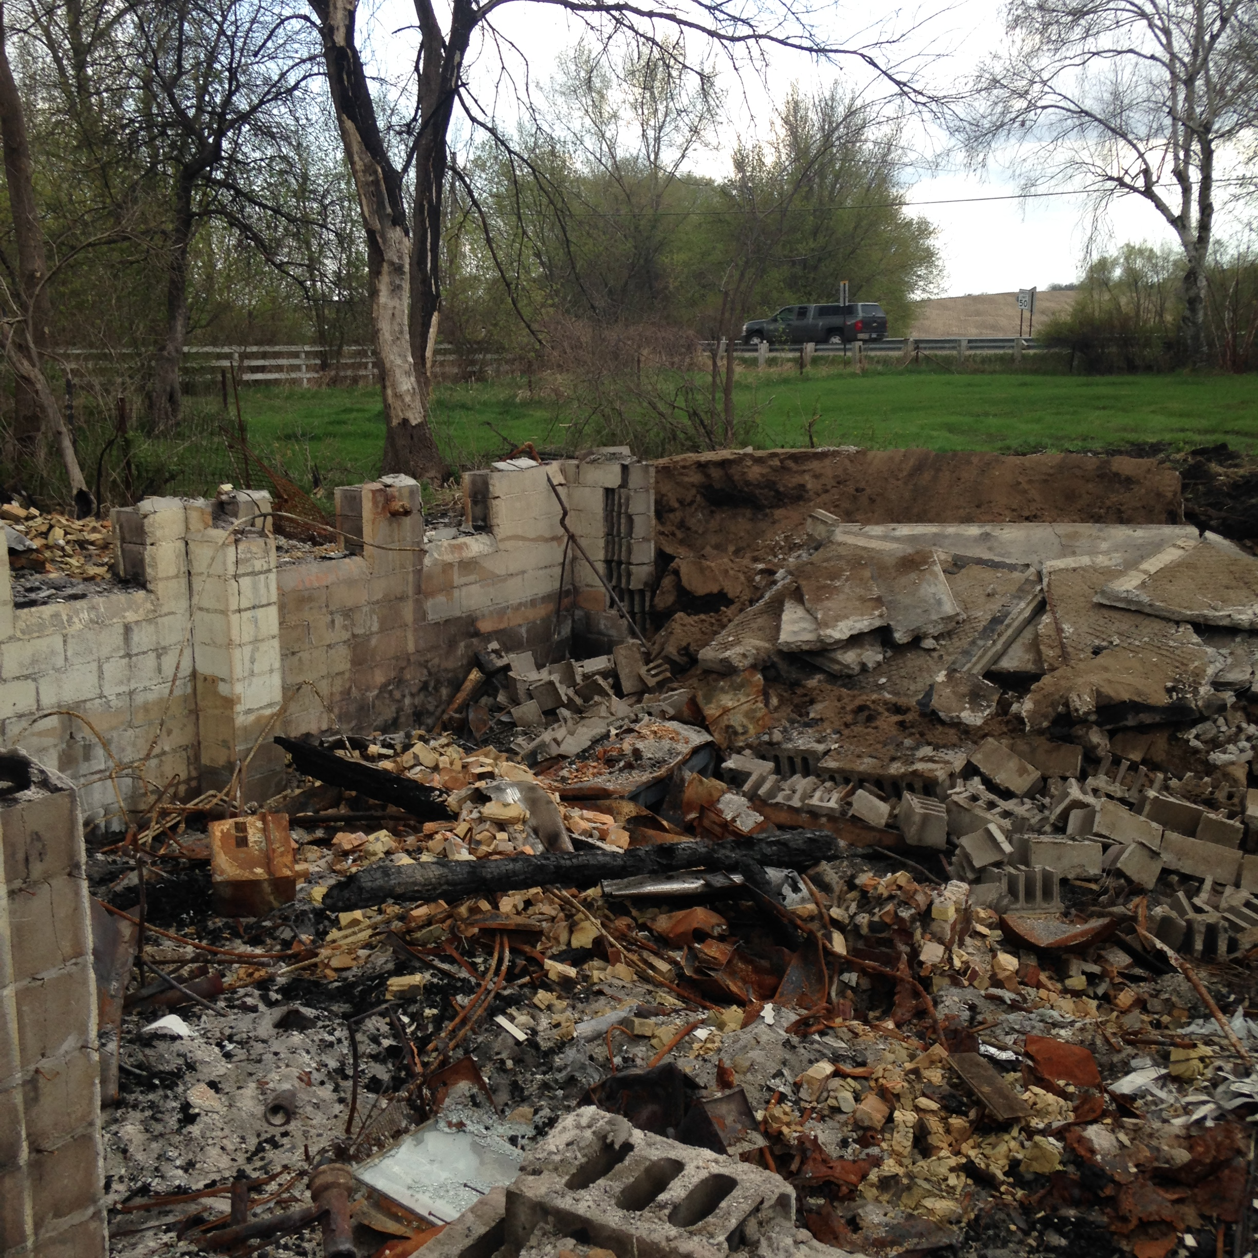
2016 Farmhouse

Slide 6
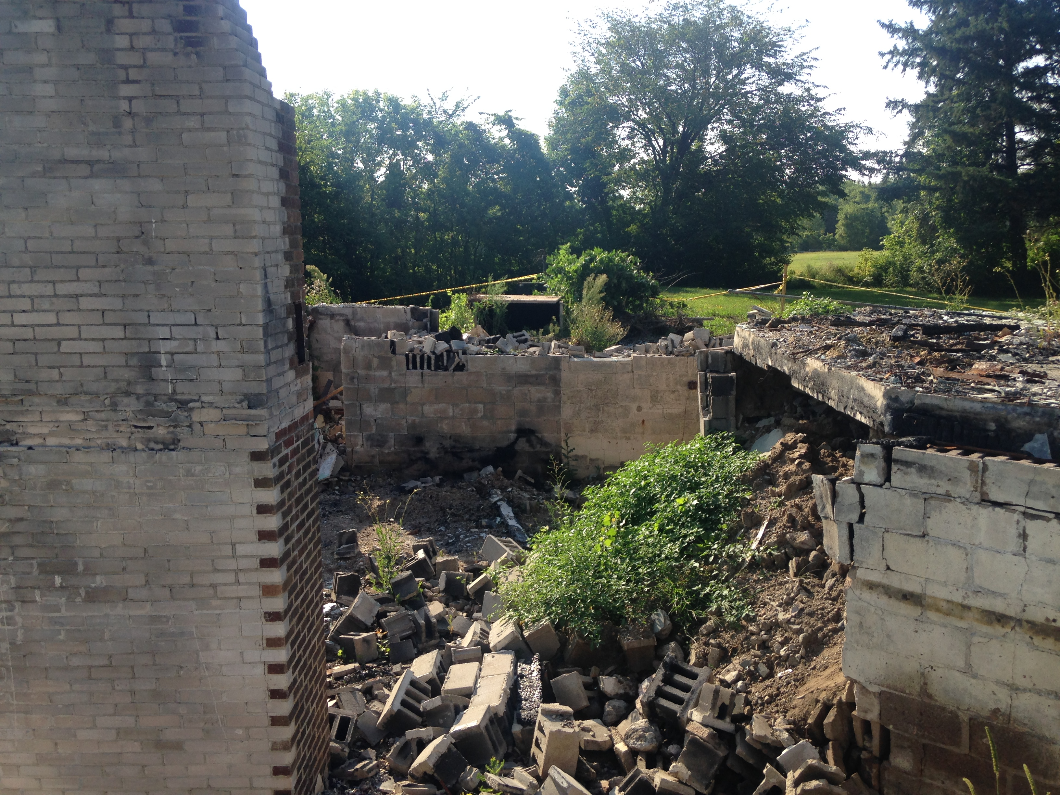
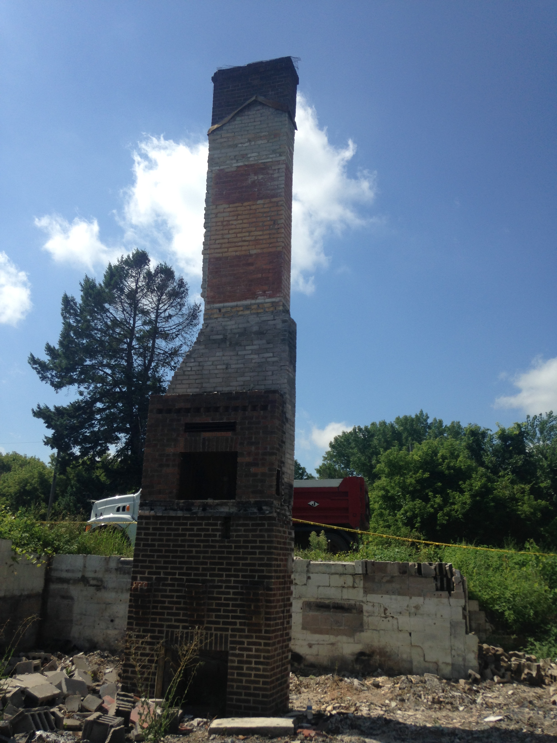
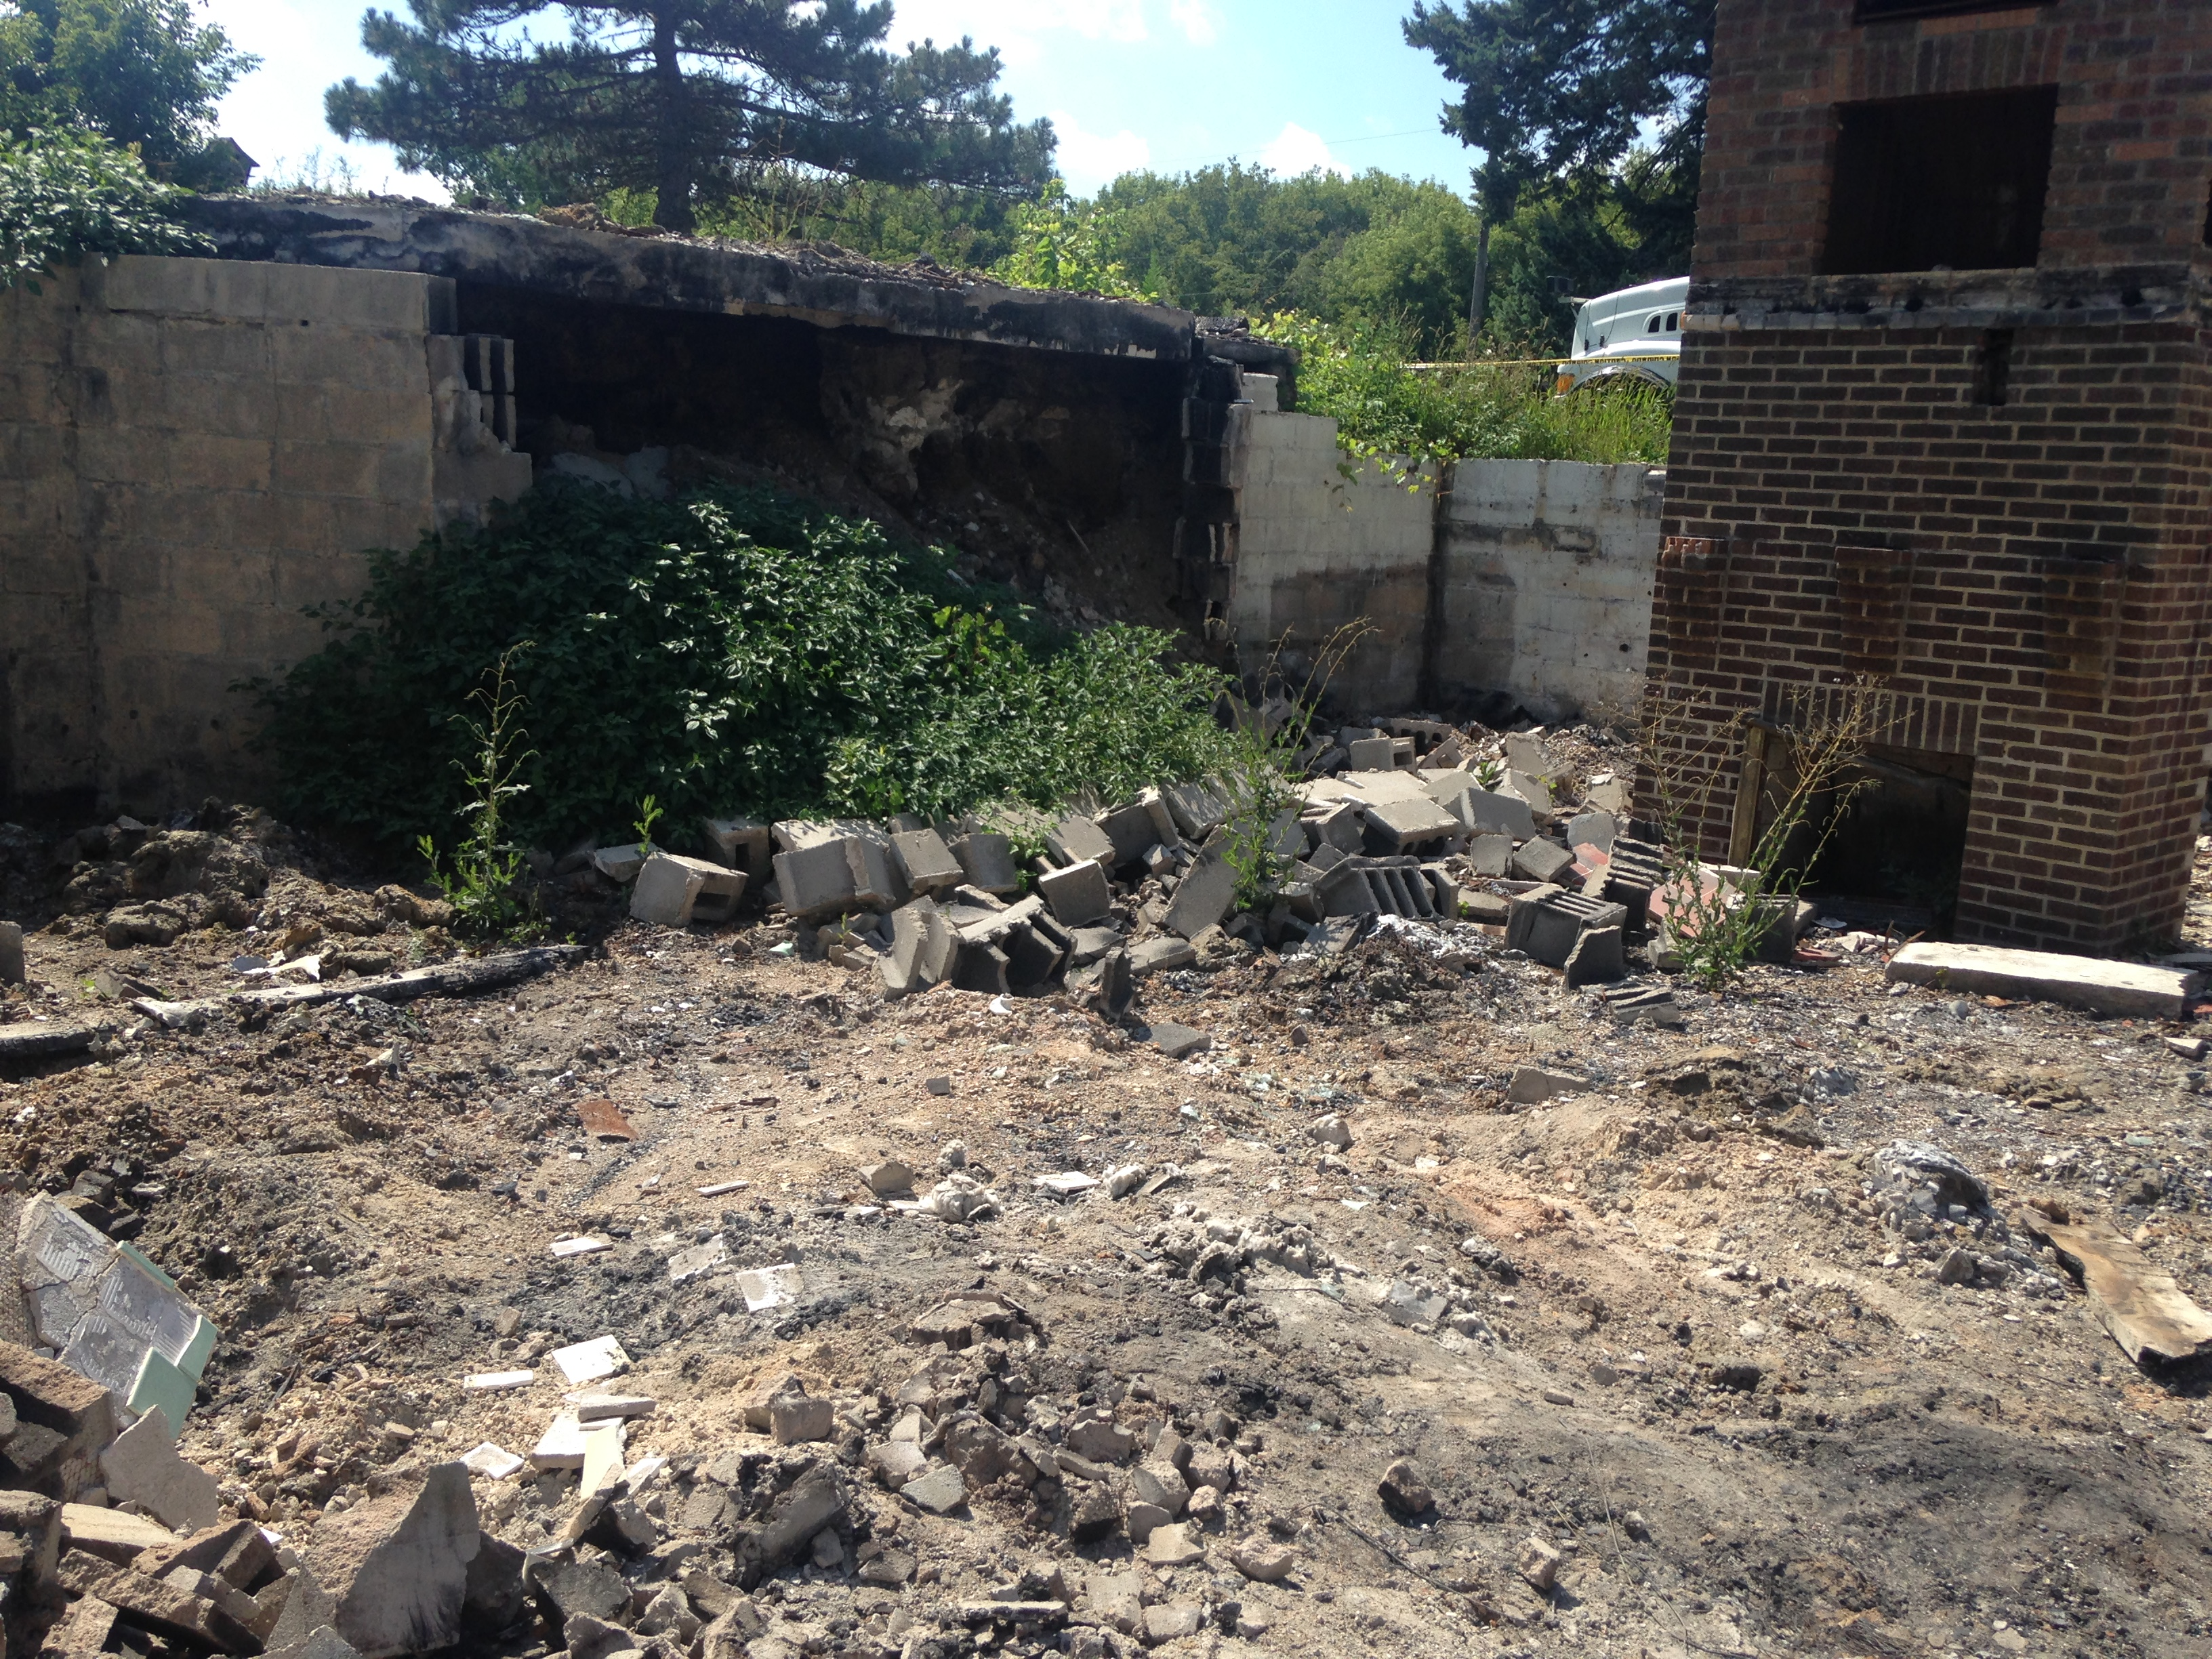
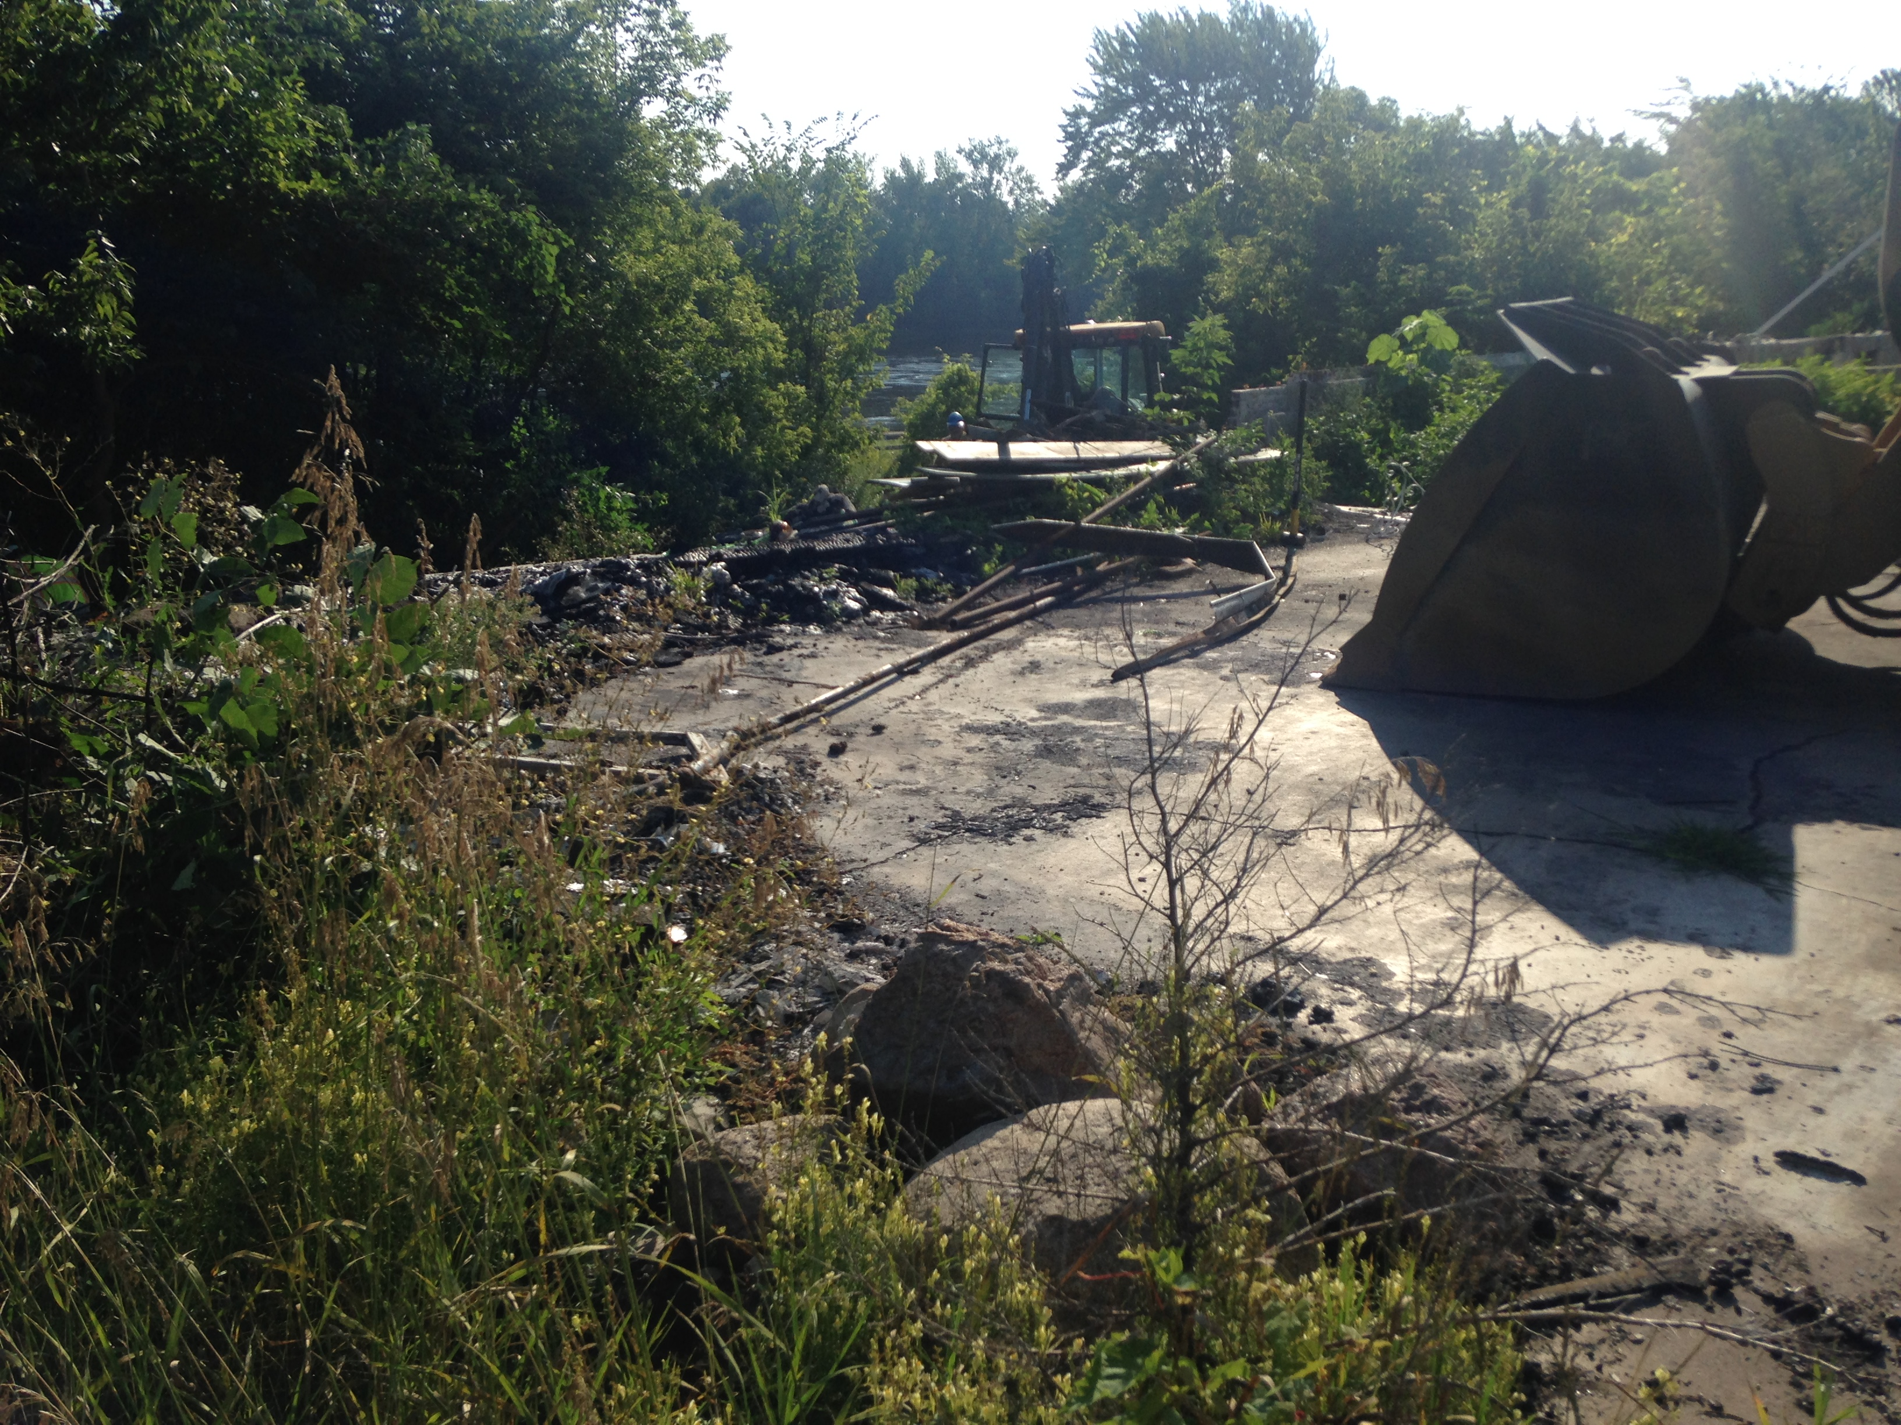
2016 Main House

Slide 7
2016
After the asbestos was abated the Fire Department conducted training exercises on the two main structures with members of other local Fire Departments. Public Works began clearing the ashes and debris and picking through the remains to separate iron for roll off boxes.
Concrete was removed and taken to Cemstone for recycling.
To date we have taken approximately 150 tons of concrete from the site and 100 tons of scrap metal.
We have also filled 10 roll off boxes (a mixture of 50 and 70 yard boxes).

Slide 8
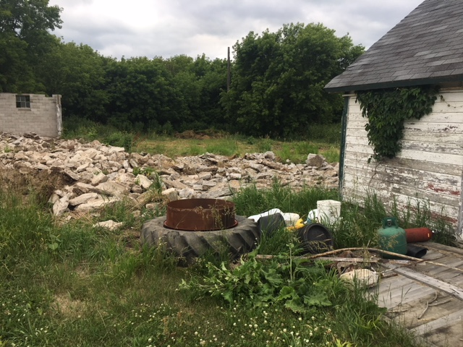
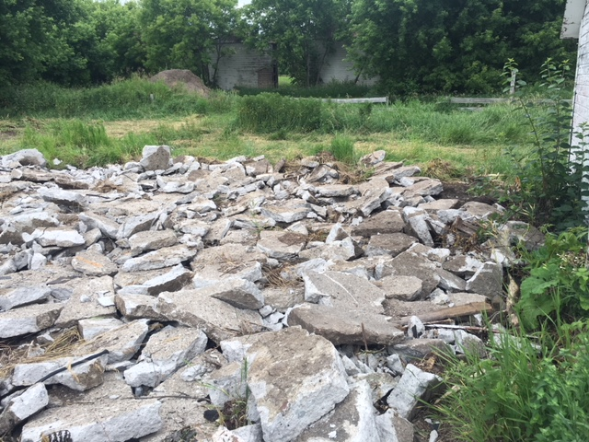
2017 Farmhouse

Slide 9
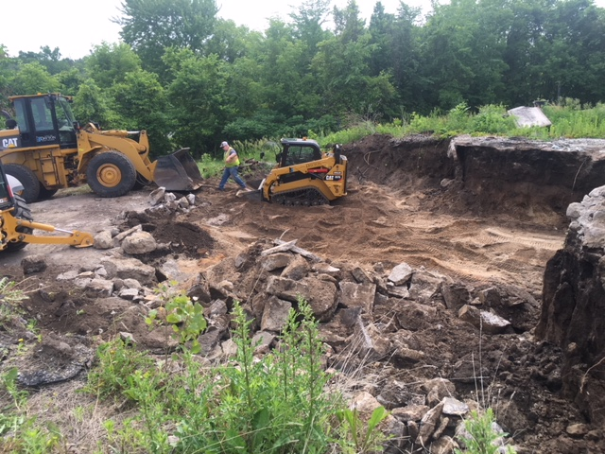
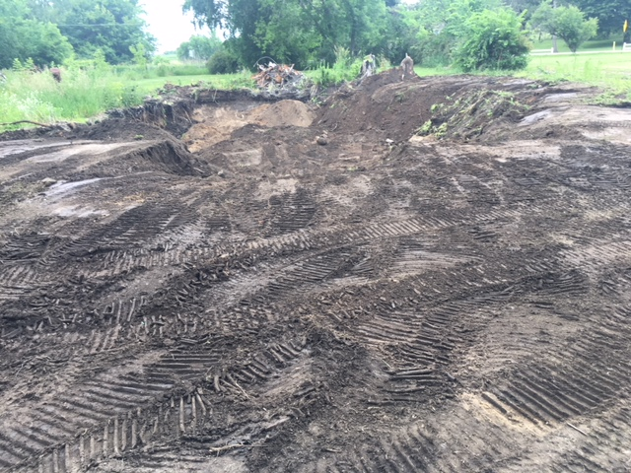
2017 Main House

Slide 10
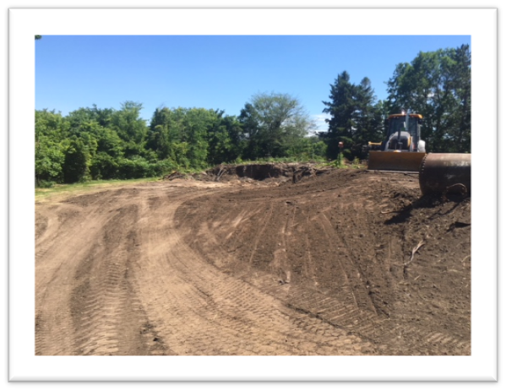
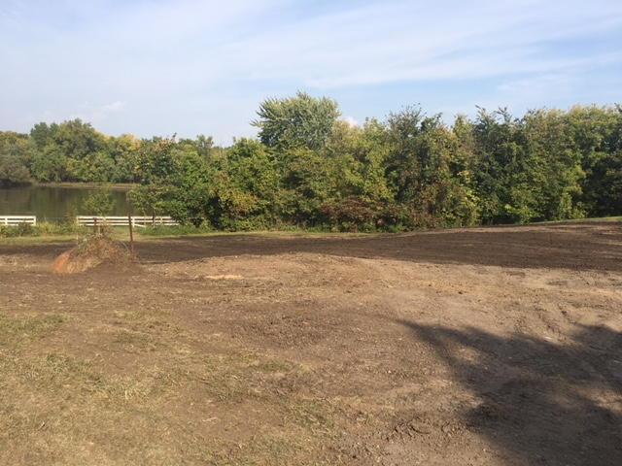
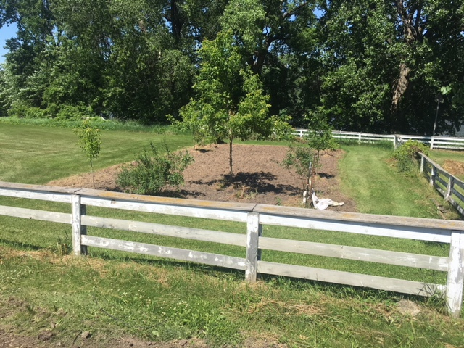
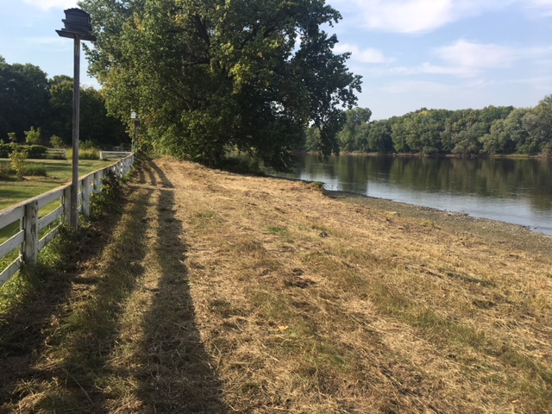
2017 Main House

Slide 11
2017
Most of PW focus was on the Main House in an effort to make this part of the site accessible to the public.
Outbuildings have been removed, concrete, steel and household debris from outbuildings was removed.
The basement and outbuilding footings have been filled and seeded.
Elsie’s garden has been revived, plantings will be done in 2018.
The riverfront of the property was cleared to provide access to the river for walking or fishing.
A picnic bench has been temporarily installed, we anticipate installing more picnic tables and possibly a bike rack this year.
A grass trail will be mowed into the pasture to the East of the site.

